Slide 1

Tampa Bay PCC Sponsor and Member Recognition

Slide 2
Gold Sponsors
Access Mail Processing Services, Inc.
Consolidated Mailing Services
FIS Output Solutions
GBS
Genesis Direct

Slide 3
Gold Sponsors
National Parcel Logistics
Neopost Florida
New York Life
TC Delivers
Time Customer Service, Inc.

Slide 4
Bronze Sponsors
Bramlett Direct Mail Services, Inc.
G.C.I. Printing Services, Inc.
OnTrac International Mail
Raymond James & Associates
Tech Data

Slide 5
Priority Sponsors
AAA Auto Club South
FNBR Inc.
Nancy Fryrear - Keller Williams Tampa Properties

Slide 6
Tampa Bay PCC 2013 New Member of the Year
Tracy Tsouris
Health Integrated

Slide 7
Tampa Bay PCC 2013 Most Active Member
Jason Bramlett
Bramlett Direct Mail Services, Inc.

Slide 8
Tampa Bay PCC 2013 Postal Member of the Year
Don Dease
USPS

Slide 9
Tampa Bay PCC 2013 Business of the Year - Small Market
Modern Print and Mail Solutions

Slide 10
Tampa Bay PCC 2013 Business of the Year - Large Market
The Florida Aquarium

Slide 11
Tampa Bay PCC 2013 Inductee to PCC Hall of Fame
Debbie Scott
Neopost Florida

Slide 12
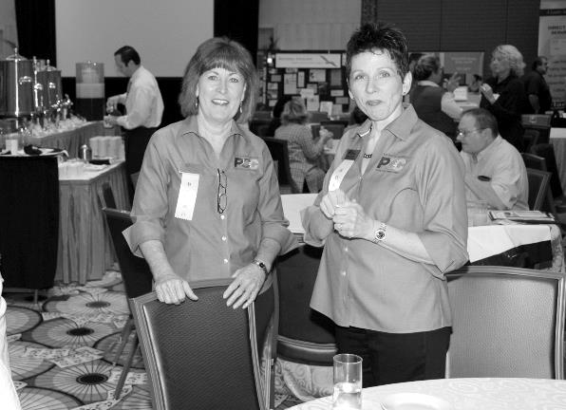
Tampa Bay PCC 2013 Inductee to PCC Hall of Fame

