Slide 1
DSCF Entry Discount Review
Tampa Bay Suncoast PCC
January 14, 2015

Slide 2
Agenda
Background
Driving Efficiency
Upcoming Changes
* Consolidation Info on RIBBS
* Labeling List Changes
* What is: Destination Sectional Center Facility Pricing (DSCF)
and Co-Located and Non Co-Located Facilities
* DSCF Pricing: Why the Change
* DSCF Discounts changes and affected locations
* District Plant Drop Shipment Locations
* Additional Information

Slide 3
Background
In September 2011, the Postal Service announced it would consolidate its processing network as part of a larger, more comprehensive plan to reduce $20 billion in costs by 2017.
On July 1, 2012, the Postal Service began consolidating its mail processing operations in a phased approach.
On Aug. 31, 2012, Phase I: Summer Consolidations ended — consolidation activities took place in 62 sites and 44 mail processing facilities were closed.
On Jan. 26, 2013, the Postal Service began the Phase I: Winter Consolidations.
On Dec. 1, 2013, Phase I: Winter Consolidations ended — consolidation activities took place in 143 sites and 91 mail processing facilities were closed.
In January 2014, the Postal Service announced that Network Rationalization Phase II had been postponed.
In July 2014, the Postal Service announced that Network Rationalization Phase II would resume effective January 2015.
On August 1, 2014, the Federal Register published the “Revised Service Standards for Market-Dominant Mail Products; Notification Implementation Date” which identifies the implementation date for the revised service standards as January 5, 2015.

Slide 4
Driving Efficiency
Future NETWORK
  Preserves Approx. 66% of Overnight Delivery Volume
  Revised Entry Times
  Reduced Equipment
  Reduced Footprint
Phase II Benefits
  Reduce Excess Capacity
  More Efficient Transportation Network
  Fully Utilized Workforce
  Up to $750 Million Cost Reduction

Slide 5
Upcoming Changes
Commencement of Phase II
  Be aware of the Consolidation sites scheduled for 2015 and changes that directly impact you and your customers
  Labeling List Schedules & Mail Direction Files
DSCF Pricing aligned with Labeling Lists and Mail Direction Files – Temporary DSCF Pricing for previously closed facilities discontinued.
Service Standard Changes
  Revised Critical Entry Times for Co-Located Facilities

Slide 6
Terminology - Defined
What is DSCF Pricing:
Destination Sectional Center Facility (DSCF) pricing is a price available for Standard Mail, Parcel Select and Bound Printed Matter that is properly prepared and entered by the mailer at the NDC or other designated postal facility that serves the delivery address on the mail.
Simply put, this is a transportation discount given to mailers who transport their mail to designated postal facilities. This replaces the of sharing the cost via postage of USPS transportation which is utilized to transport BMEU entered mail to those designated facilities.

Slide 7
Terminology - Defined
What are Co-Located and Non Co-Located Facilities:
Co-Located Facilities (BMEU’s) are those that are actually housed/located in a USPS processing plant. (Orlando, Manasota & Ft. Myers)
Non Co-Located Facilities (BMEU’s) are those who are located at a physical address that is not part of a processing plant. (All other Suncoast District BMEU’s)

Slide 8
Changes
DSCF Pricing: Why the Change
Effective January 5, 2015 to qualify for DSCF pricing mailers will be required to enter mail at the SCF defined in Labeling List
  See Federal Register/ Vol. 78, No. 243, Dec.18, 2013 http://www.gpo.gov/fdsys/pkg/FR-2013-12-18/pdf/2013-29879.pdf
Why the change for the Tampa BMEU which was not part of the plant consolidation process: During a mid October review of proposed consolidation facilities, Mailing List and Directional File which affected Co-located and Non Co-located Business Mail Entry Units (BMEU) it was discovered DSCF pricing discounts were being given to Non Co-located BMEU customers. Tampa is a Non Co-located BMEU. Based on the Federal Registry Notice it was determined to eliminate this incorrect pricing discount with the January 5, 2015 removal of all other temporary authorized DSCF discounts.
BMEU/PVDS Mailers are to prepare mail according to effective Labeling Lists
Mailers are encouraged to align their preparation and entry to the new network for the best service and lowest pricing

Slide 9
BMEU Acceptance Changes
BMEU Acceptance Changes for Mailers Not Utilizing Drop Shipments:
For customers using Courtesy Drop Locations there are No Changes as drop shipments are not an option.
For Customers currently utilizing SCF Discounts and entering mailings at Co- Located BMEU’s there are no changes.
For Customers currently utilizing SCF Discounts and entering mailings at Non Co-Located BMEU’s the following will need to take place:
* “DSCF” Entry discount options on all postage statements must be discontinued and the “None” Entry option is to be selected.

Slide 10
BMEU Acceptance Changes
BMEU Acceptance Changes for Mailers who choose to claim the “DSCF” Entry Discount and utilize Local Drop Shipments:
For customers using Courtesy Drop Locations (CDP’s) there are No Changes as this is not an option.
For Customers currently utilizing SCF Discounts and entering mailings at Co- Located BMEU’s there are no changes.
For Customers currently utilizing SCF Discounts and entering mailings at Non Co- Located BMEU’s the following will need to take place:
* “DSCF” Entry discount options on postage statements will continue to be selected.
* A PS Form 8125 “Plant-Verified Drop Shipment (PVDS) Verification and Clearance” form must be completed (mailers portion) and submitted with each mailing to be drop shipped.
* Appointments for destination postal facilities must be scheduled through the FAST appointment system website which is located at: fast@usps.gov – Failure to do so could result in a long wait time as destination facility.

Slide 11
Required Tampa BMEU Acceptance Changes
Tampa BMEU Acceptance Changes for Mailers who choose to claim the “DSCF” Entry Discount Utilizing Drop Shipments Continued:
* Mailings must be dropped during normal business hours at the Tampa BMEU for clearance, billing and verification processes.
* Mailer will be contacted by BMEU staff after stated process are completed that documentation and mail are ready for mailer pick up.
ITEMS OF NOTE:
Appointments cannot be made for the dropping off of mail, it is a first in first out process. Advanced notification of drop shipments coming to BME will assist in providing proper staffing which may lead to a quicker turn around process.
It is recommended you submit your Postage Statements electronically!!!
It is recommended that you drop your mail earlier in the day.

Slide 12
Required Tampa BMEU Acceptance Changes
Tampa BMEU Acceptance Changes for Mailers who choose to claim the “DSCF” Entry Discount Utilizing Drop Shipments Continued:
Appointments for destination postal facilities must be scheduled through the FAST appointment system website which is located at: fast@usps.gov
Drop Locations for Tampa area drop shipments:
Tampa P&DC – 3501 Bessie Coleman Blvd. Tampa, FL 33630
Ybor City P&DC – 1801 Grant St. Tampa, FL 33605
NOTE: Use the FAST system to determine which mailings can be dropped at each location.

Slide 13
Drop Shipment Locations For Suncoast District Non Co-Located Temporary SCF BME sites:
Drop Locations for Orlando Area drop shipments
(mailings entered at Mid FL BMEU)
Orlando P&DC – 10401 Post Office Blvd. Orlando, FL 32862
Seminole P&DC – 2036 E Landstreet Rd. Orlando, FL 32824
Drop Location for Manasota P&DC drop shipments
(mailings entered at St. Petersburg and Lakeland BMEU’s)
850 Tallevast Rd. Sarasota, FL 34260
Drop Location for Ft. Myers P&DC drop shipments:
14080 Jetport Loop Ft. Myers, FL 33913
NOTE: Use the FAST system to determine which mailings can be dropped at each location.

Slide 14
Upcoming Changes
Service Standard Changes
There will be Service Standard Changes for presort First-Class Mail and Periodical Mail.
For First-Class Mail Presort: Properly prepared and containerized intra-SCF Presort FCM volume entered at the SCF plant by the 08:00 CET for mixed Intra-SCF and by the 12:00 CET for 5-Digit/Scheme will receive overnight service.
  Intra-SCF single-piece mail or maximum 6 hour drive time between originating facility and SCF facility will receive 2-Day Service
  Everything else will receive 3-5 day.
End-to-End Periodicals transported with First-Class Mail pieces on surface transportation move to a minimum 3-day service standard (equal to the sum of 1 day plus the FCM service standard).
  There is no change to destination entered Periodicals.”
All Current Delivery Standards can be found at Ribbs.usps.gov under the Service Standards (formerly Modern Service Standards) link

Slide 15
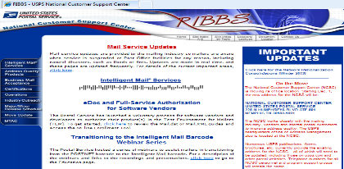
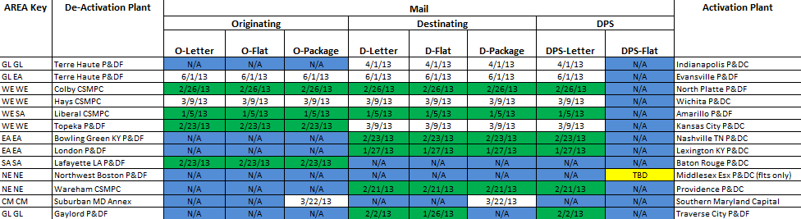
Upcoming Changes
  Consolidation Sites Scheduled for 2015 & Mail Move Plan is updated and posted on RIBBS
  https://ribbs.usps.gov
RIBBS
Enables mailers to plan consolidation implementation progress
File provides targeted mail move consolidation site information, type, and date
Mail Move Plan File

Slide 16

Questions?

