Slide 1
Southern Area
Operational Window Change
Effective January 5, 2015
August 21, 2014

Slide 2
The Network of the Future

Slide 3
Volume Decline
16.4% decline since AMP packages developed
Source: RPW, FY2007 – FY2013

Slide 4
New FCM Business Rules
Overnight: Properly prepared Presort mail entered by applicable CET
2-day: Maximum 6 hour drive time (including STC time) between originating facility and SCF facility (Every remaining plant except for DDC’s will be an ADC)
3-5 day: Everything else
https://www.federalregister.gov/articles/2014/08/01/2014-18223/designation-of-implementation-date-revised-service-standards-for-market-dominant-mail-products
4

Slide 5
Expected Volume Distribution
 | % 1-Day | % 2-Day | % 3-Day | % 4-Day | % 5-Day | Average Days to Delivery
Current* | 30.51% | 25.14% | 44.03% | 0.31% | 0.00% | 2.14
Future | 20.05% | 35.60% | 44.03% | 0.31% | 0.00% | 2.25
Preserves ~ 66% of overnight volume
*FY2013 ODIS Average Daily Volume and FY2013Q4 First Class Mail Service Standards

Slide 6
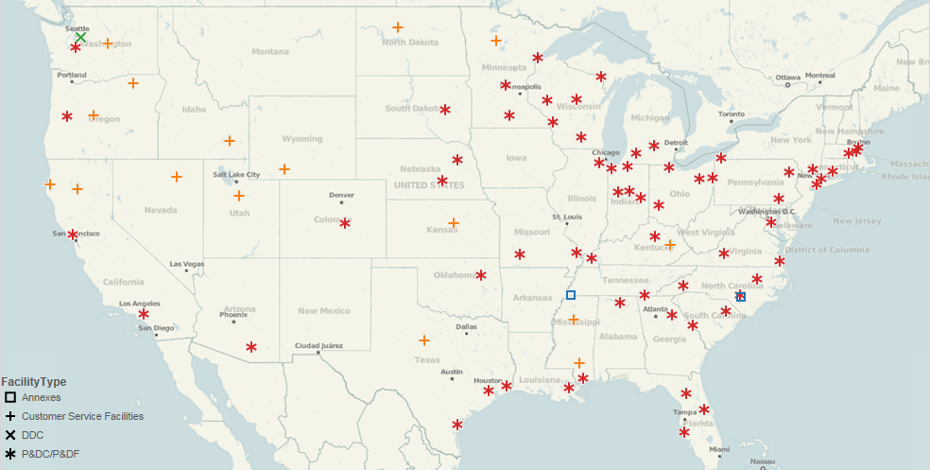
Phase II Consolidations
82 mail processing sites in 2015
Facility Type | Total
Annexes | 2
Customer Service Facilities | 16
DDC's | 1
P&DC/P&DF's | 63
Total | 82

Slide 7
Southern Area Phase II Consolidations
14 Mail Processing sites in 2015

Slide 8
Plant Consolidation
Decrease in Processing Locations Through 2016
239
At start of FY – Includes STC’s, NDC’s, ISC’s, DDC’s, Rec Sites
Notes:
8

Slide 9
Operational Window Shifts

Slide 10

National Concept of 24-Hour Plant Operations Operational Window Change
Outgoing
Operations
(5:00 PM –
12:30 AM)
Continuous
DPS/Secondary
Operations
(12:00 PM – 6:00 AM)
(SA-12:00PM-4:00 AM)
24:00
Remittance/Caller Service
Processing
(8:00 AM -6:00 AM)
18:00
06:00
08:00
12:00
Incoming Primary
Operations
(8:00 AM – 12:00PM)
(SA-4:00AM-12:00PM)
BMEU
(8:00 AM –
7:00 PM)

Slide 11
Priority Mail – No Change
0800
1200
1600
2000
2400
0400
0800
Current Processing
Originating
(1700-0115)
Destinating
(0800-0400)
Future Processing
Originating
(1700-0115)
Destinating
(0800-0400)

Slide 12
Originating FCM Letters/Flats – Current vs Future
0800
1200
1600
2000
2400
0400
0800
Current Processing
Cancellation
(1700-2200)
Outgoing Primary
(1730-2300)
Outgoing Secondary
(1800-2400)
Future Processing
Cancellation
(1700-0050)
Expansion of outgoing operating windows only for those sites consolidating originating mail
Outgoing Primary
(1730-0100)
Outgoing Secondary
(1800-0130)

Slide 13
Key Principles
There is an overnight delivery standard for commercial mail entered by the CET
There is an overnight delivery performance for both commercial mail and single piece first class mail
Anticipate that 66% of current overnight delivery performance will remain under Phase 2 Network Rationalization (Commercial entered by CET and 1/3 of Blue Box Mail)

Slide 14
Transportation Changes due to CET Changes
CET for 2 Day and 3 Day Destinating Volumes is changing from 1600 to 0800
  $124 million is being budgeted for additional air transportation
  Realignment of surface network (some 3 day destinating trips may arrive up to 9:30 am on Day 2)
  Revaluation of STC & CDF/Pref network
  Evaluate Fedex Contract impact

Slide 15
Commercial Mail CET’s
Two Critical Entry Times for Commercial Mail
  8:00am
    Mail tendered by 8:00am destined for that plant’s local delivery area requiring a primary sortation, will have an overnight delivery standard
  Noon
    Mailers who enter presorted mail, properly prepared, and containerized by L012 Labeling List (DPS Sort Program Zip Grouping), and entered by CET of noon, will have an overnight first class service standard for mail destinating to the local plants service area

Slide 16
Destinating Letters – Current vs Future
0400
0800
1200
1600
2000
2400
0400
Current Processing
Incoming Primary
(0800-2000)
DPS Processing
(2200-0600)
Remittance/Caller Service
(0800-0600)
Future Processing
Incoming Primary
(0400-1200)
Incoming Primary (Standard)
(1600-0400)
DPS Processing
(1200-0400)
Remittance/Caller Service
(0800-0600)

