Slide 1
Agenda
Benefits of IMpb
IMpb Requirements
  Unique Barcode
  Shipping Services File (SSF)
Postal Wizard Enhancements to support IMpb Acceptance
Small Business tools for savings

Slide 2

Benefits of IMpb for Mailers
The Intelligent Mail package barcode (IMpb) offers a number of benefits to mailers by providing piece-level visibility throughout USPS™ processing and delivery operations
Other benefits of IMpb use include:
The best commercial prices with the largest discount available
Piece-level tracking information at no additional charge for most products
Access to new products, services, and enhanced features

Slide 3
IMpb Requirements:
Applicable Classes of Mail
Effective January 2014, the Intelligent Mail package barcode (IMpb) requirements are changing for all parcels entered through commercial channels including, but not limited to:
  Priority Mail ExpressTM
  Priority Mail®
  First-ClassTM Package Services
  Parcel Select
  Parcel Select Lightweight
  Postage paid by:
    Permit imprint
    Postage meter
    PC Postage®
    Precancelled stamps
    Franked Mail or Official Mail Accounting System

Slide 4
IMpb Requirements
Effective January 2014
To receive commercial rates, mailers must comply with the following requirements:
Requirements Effective January 26, 2014
Use a unique Intelligent Mail package barcode (IMpb) on each mailpiece Prepared in accordance with DMM 708.5.1 Submit an electronic Shipping Services File (SSF), version 1.6 (or higher) Include the correct destination delivery address or ZIP+4 Code in the SSF Refer to SSF layout specifications in Publication 199 https://ribbs.usps.gov/intelligentmail_package/documents/tech_guides/PUB199IMPBImpGuide.pdf

Slide 5
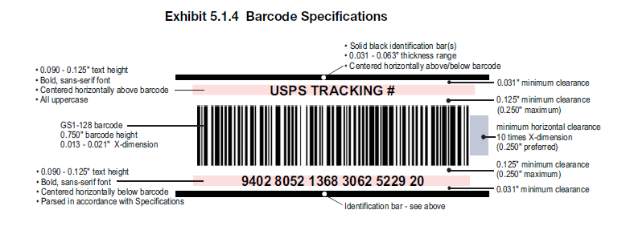
IMpb Requirement: Unique IMpb Barcode
Requirement to use a unique IMpb barcode prepared in accordance with DMM 708.5.1 (Standards for Package and Extra Service Barcodes: Intelligent Mail Package Barcode)
From DMM 708.5.1
The DMM can be accessed through Postal Explorer (pe.usps.gov).
Direct link to DMM section 708.5.1: http://pe.usps.gov/text/dmm300/708.htm#1619562

Slide 6
IMpb Requirement:
Shipping Services File (SSF)
The Shipping Services File (SSF) is required for Intelligent Mail® Package barcode participation by commercial and online package or Extra Service customers who communicate electronically with the USPS
The SSF must contain:
    Unique SSF Transaction ID (SSF TID)
    Rate and Payment indicators
    5-digit ZIP Code where permit is held
    Class of Mail
    Processing category
    Total # of Mailpieces
Refer to SSF layout specifications in Publication 199 https://ribbs.usps.gov/intelligentmail_package/documents/tech_guides/PUB199IMPBImpGuide.pdf

Slide 7
IMpb Requirement:
Shipping Services File (SSF)
Recipient delivery address or ZIP+4 is required
Complete piece level delivery address information includes:
  Addressee name (required when needed for the service)
  Private mail box designator and number
  Urbanization name
  Street number and name
  Secondary Address unit designation and number
  City and state
  Correct 5-digit ZIP Code or ZIP+4 Code
Note: elements of a complete address are described in DMM 602.1.4.2

Slide 8
IMpb Requirement:
Shipping Services File (SSF)
Mailers must submit the electronic Shipping Services File (SSF) using one of two methods:
Option 1 – eVS: Electronically submit a Shipping Services File with postage, manifest, and tracking information in one file (through the electronic Verification System - eVS®)
  Submission is one file and includes the Shipping Services File, ZIP+4 or destination delivery information, and postage statement information
  Payment for postage is deducted from a centralized electronic postage payment account (a Centralized Account Processing System – CAPS account)
Option 2 – Postal Shipping Business Tool : Electronically submit a Shipping Services File through the Postal Shipping Business Tool plus a separate Postage Statement (this option is referred to as a Manifest Mailing Solution)
  Submission includes the Shipping Services File, ZIP+4 or destination delivery information
  A hardcopy Postage Statement must be brought to the Business Mail Entry Unit (BMEU) or an electronic Postage Statement submitted through the Postal Wizard
  Payment for postage is made through a local payment or trust account, or a CAPS account

Slide 9


IMpb Requirement:
Shipping Services File (SSF) Validation
Mailers are required to transmit their SSF to Product Tracking and Reporting (PTR) prior to the physical presentation of the mailing
Three types of verifications are performed on an IMpb mailing:
  IMpb Barcode Compliance Verification
    Completed by the acceptance clerk when prompted by PostalOne!
  Shipping Services File (SSF) Compliance Verification
    Compliance percentages are automatically verified by PTR and data sent to PostalOne!
  Zip+4 Address Verification
    Compliance percentages are automatically verified by PTR and data sent to PostalOne!
Note: For more information on SSF submissions, reference Pub 199: The Implementation Guide to IMpb for Confirmation Services and eVS® Mailers

Slide 10

PostalOne! Enhancements
Mailers may pay postage for their IMpb mailings in one of three ways:
  eVS (SSF included, no postage statement is required)
  Shipping Services File (SSF) (non eVS), hard copy postage statement
  Shipping Services File (SSF) (non eVS), electronic postage statement
10

Slide 11
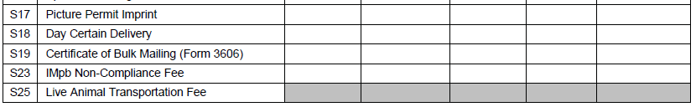
Postage Statement
Enhancement to support IMpb
A new line S23 has been added to Part S (Extra Services) of PS Forms 3600 FCM, 3600 PM, and 3605 (Parcel Select and Parcel Select Lightweight only) for the IMpb Non-Compliance Fee
If the piece count is greater than the percentage allowable for package types in more than one category, PostalOne! will use the greater number of non-compliant pieces
  Pieces will not be double counted for non-compliance
An error message will be displayed for the mailing if the barcode count is below the configurable percentage of packages allowed in a job

Slide 12
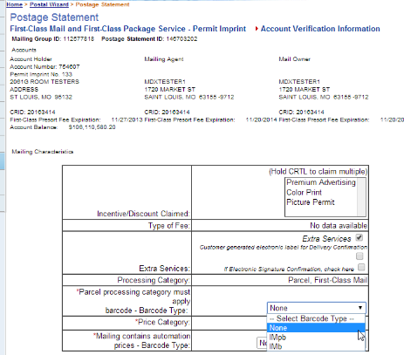
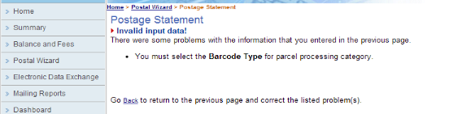
Postal Wizard Enhancements
On the Postage Statement Account Verification page, when the processing category of “Parcels” is selected, the Barcode Type dropdown now includes IMpb.
New parcel “Barcode Type” dropdown now includes IMpb
If no selection is made, an error message will appear

Slide 13
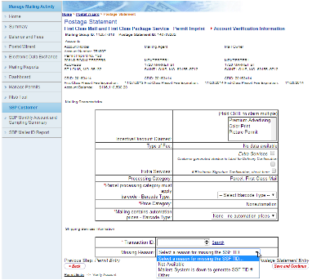
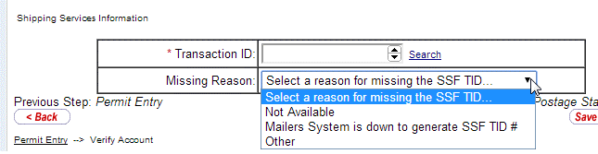
Postal Wizard Enhancements
SSF TID# field is a required field whenever the processing category of parcels is selected
  If no TID# is given, users must select a reason from the dropdown
    Note: if no SSF TID# has been provided, mailers must claim the S23 extra services fee
When a processing category of “parcels” is selected, a Transaction ID field will display as a dropdown with the mailer’s prepopulated Transaction ID (TID).

Slide 14
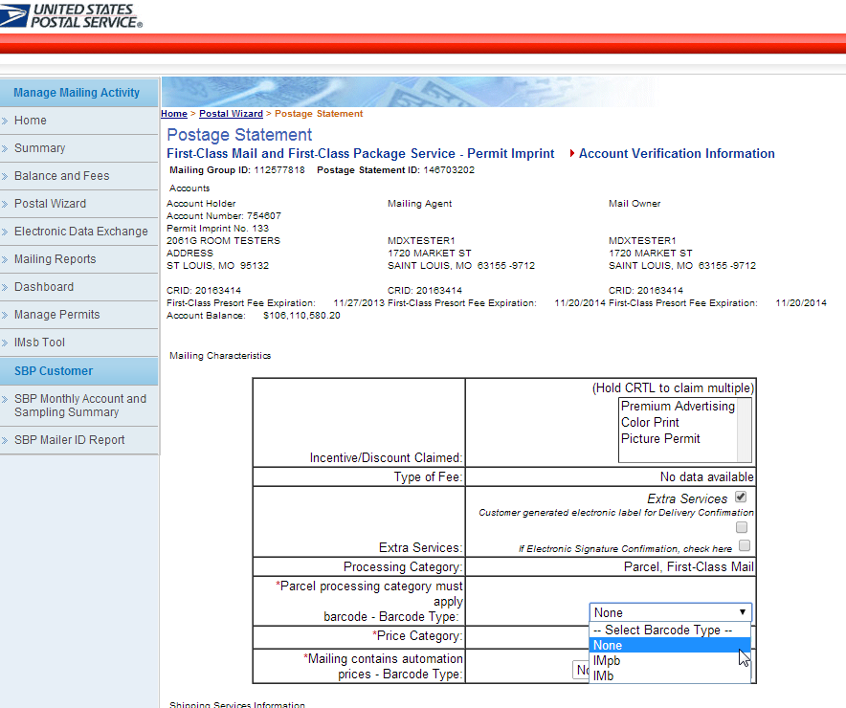
Postal Wizard Enhancements to support IMpb Compliance
If the mailer does not provide a SSF TID or if “None” is selected from the Barcode Type dropdown, the Extra Services will automatically be checked and a non-compliance fee will be assessed

Slide 15
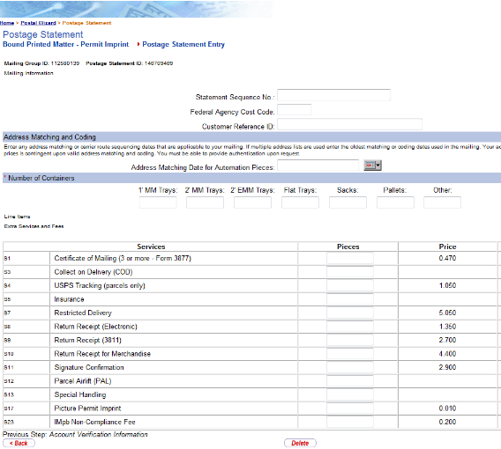
Postal Wizard Enhancements to support IMpb Compliance
If the Extra Services box is checked from the previous screen and/or IMpb barcodes are not provided on mailpieces, users are required to enter the total number of noncompliant mailpieces on line S23
This fee will then be included as part of the postage statement for the mailing and charged to the mailers’ applicable PostalOne! account

Slide 16
Tools for Mailers
There are several tools available to help mailers meet the IMpb and data submission requirements:
Use a certified vendor software solution
  See list on next slide; latest are posted on https://ribbs.usps.gov/evs
Use a certified consolidator solution
  See list on next slide; latest are posted on https://ribbs.usps.gov/evs
Become an eVS mailer
  Contact the eVS Help Desk at evs@usps.gov or 877-264-9693 (select option 3) for help signing up or for more information
Use the new USPS Postal Shipping Tool
  Note: Additional information is available at https://gateway.usps.com under “Shipping Services”

Slide 17
Electronic Verification System (eVS)
Enables parcel mailers to submit documentation and pay postage by transmitting electronic manifest files to the eVS database, which is part of the PostalOne! System
The first option for meeting the new IMpb requirements is to electronically submit postage, manifest, and tracking information in one file via eVS
  Single file includes the Shipping Services File, destination delivery address or ZIP+4, and postage statement information
  Payment for postage is deducted from a centralized electronic postage payment account (a Centralized Account Processing System – CAPS account)
Contact the eVS Help Desk at evs@usps.gov or 877-264-9693 (select option 3) for help signing up or for more information

Slide 18
References
Package Information Sheet – Provides an overview of the new requirements and the list of certified solutions providers
  https://ribbs.usps.gov/intelligentmail_package/documents/tech_guides/IMpbCertifiedSolutionsProviders.pdf
RIBBS: Intelligent Mail Package Barcode (IMpb) page:
  http://ribbs.usps.gov/index.cfm?page=intellmailpackage
IMpb Frequently Asked Questions (FAQ):
  https://ribbs.usps.gov/intelligentmail_package/documents/tech_guides/IMPB_FAQs.pdf
Publication 199: IMpb Implementation Guide for Confirmation Services and eVS – provides implementation details regarding the Shipping Services File
  https://ribbs.usps.gov/intelligentmail_package/documents/tech_guides/PUB199IMPBImpGuide.pdf
RIBBS: eVS (Electronic Verification System) page:
  https://ribbs.usps.gov/evs
eVS Help Desk – for assistance in eVS sign-up and questions
  email: evs@usps.gov; phone: 877-264-9693, option 4

Slide 19
Other Ways to Mail Packages for Small Businesses
There are several other ways to mail packages
  Endicia.com
  Stamps.com
  Click ‘n Ship
Using any of these methods qualifies for Commercial Base Pricing
  Commercial Based Prices are 10 to 15% than Retail Prices
Find out at usps.com

Slide 20
Retail vs. Commercial Base
Medium Flat Rate Box
  Retail $12.65
  Commercial Base $11.30
    $1.35 or a .107% savings
15 lb. package mailed to Zone 6
  Retail $39.40
  Commercial Base $33.66
    $5.74 or a .146% savings
10 lb. package mailed to Zone 3
  Retail $12.75
  Commercial Base $ 8.49
    $4.26 or a .334% savings

Slide 21
Try: Shipgooder.com
  Gives rates from the big 3 delivery companies
    USPS
    FedEX
    United Parcel Service

Slide 22

Questions?

