Slide 1
JANUARY 2016 PRICE AND PRODUCT CHANGES
TAMPA BAY SUNCOAST PCC
JANUARY 5, 2016

Slide 2
Agenda
Changes By Class of Mail
Changes in Extra Services, Parcel Returns & Mailer Services
Postage Statements
Impb & Shipping Services File Updates
Coming Initiatives
Resources
2
Notes:
The USPS continues to identify and develop ways to work closer and better with its
customers, including the thousands of state and local government officials who
are responsible for voter registration and conducting ballot elections.
A latticework of laws, statutes, and regulation provides the structure within which
the USPS and election officials conduct their respective activities. Fairly specific
rules aimed at simplification and conformity, with the goal of greater efficiency and
effectiveness and reduced costs for all concerned. In addition to federal laws and USPS
guidelines, each state has its own regulations concerning election mailings.
The Postal Service provides information on mail requirements and specifications in
many ways – through the Domestic Mail Manual, dozens of smaller manuals and
publications on specific topics in our Rapid Information Bulleting Board System (RIBBS),
and on the worldwide web, at www.usps.com Most importantly, though, are our Postal
Service professionals, an unequaled network of experts in every facet of mailing.
Today, we will discuss Political and Election Mail, including use of Tags 57 and 191; specific
information for mail preparation and design, steps for a successful mailing, and resources
to assist you prepare your mailing.

Slide 3
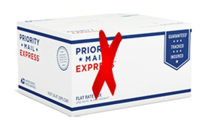
Changes by Class of Mail
Priority Mail Express
Priority Mail Express prices will increase 15.6 percent
Priority Mail Express will continue to offer zoned Retail, Commercial Base™, and Commercial Plus™ pricing tiers
Discontinued use of Priority Rate Express Flat Rate Boxes
Commercial Base prices will continue for customers who use authorized postage payment methods

Slide 4
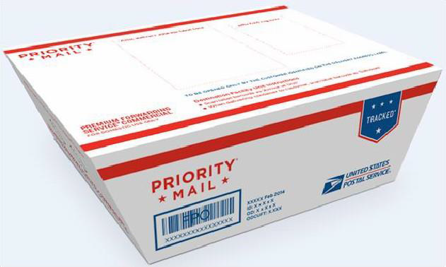
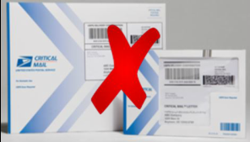
Changes by Class of Mail
Priority Mail
Priority Mail prices will increase 9.8 percent
Continued Zoned Retail, Commercial Base™, and Commercial Plus™ pricing tiers
Critical Mail Option Discontinued, Critical Mail Letters and Flats to be charged at Commercial Plus Flat Rate Envelope Price
Priority Regional Rate Box Changes

Slide 5
Changes by Class of Mail
First Class Package Services
First Class Package Service prices will increase 9.8 percent
The Intelligent Mail® package barcode (IMpb) will continue to provide free USPS tracking and confirmation of delivery with these parcels.
The Postal Service will discontinue First-Class Package Service Commercial Plus pricing and restructure First-Class Package Service commercial parcel prices to simplify this product offering.
First-Class Package Service commercial parcels will only be a single-piece product with prices starting at 1 ounce up to less than 16 ounces.
First-Class Package Service commercial parcels will not be sealed against inspection.

Slide 6
Changes by Class of Mail
Parcel Select & Standard Post
Parcel Select Destination Entry prices will increase an average of 4.9 percent.
The prices for Parcel Select Lightweight® (PSLW) will increase an average of 23.5 percent.
The Postal Service will rename Parcel Select Nonpresort as Parcel Select Ground.
The Postal Service will consolidate the Parcel Select Lightweight Machinable and Irregular price tables to simplify this product offering.
Standard Post prices will increase an average of 10.0 percent.

Slide 7
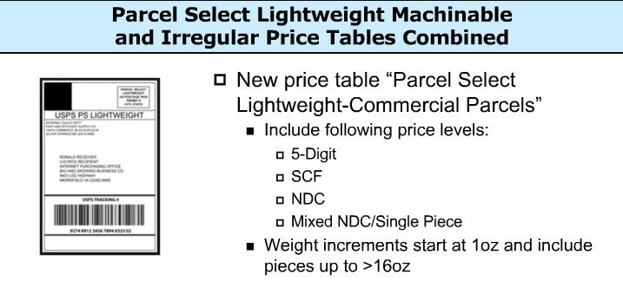
Changes by Class of Mail
Parcel Select & Standard Post
The Postal Service will consolidate the Parcel Select Lightweight Machinable and Irregular price tables to simplify this product offering.

Slide 8
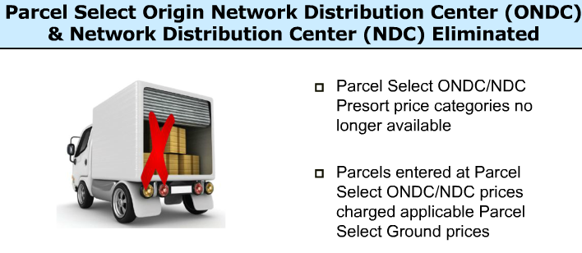
Changes by Class of Mail
Parcel Select & Standard Post
The Postal Service will discontinue the Parcel Select ONDC and NDC price categories to simplify product offerings.
Notes:
•

Slide 9
Changes by Class of Mail
Extra Services, Parcel Return Service & Mailer Services Changes
Adult Signature Required and Adult Signature Restricted Delivery service prices are increasing 3.6 and 3.5 percent respectively.
Parcel Return Service (PRS) prices will increase an average of 5.0 percent.
The Parcel Return Service annual permit fee and annual account maintenance fee will not change at this time.
The Postal Service will discontinue the RNDC price option to simplify this product offering.

Slide 10
Changes by Class of Mail
Extra Services, Parcel Return Service & Mailer Services Changes Continued
The Postal Service is introducing a reduced Additional Service Fee for Parcel Select shippers who use IMpb™ ACS™ with Shipper Paid Forward/Return, when those packages are forwarded or returned.
Premium Forwarding Service® (PFS®) prices will increase an average of 3.6 percent
The USPS Package Intercept™ fee will increase 3.3 percent to $12.55
The Postal Service is restructuring Click-N-Ship® to offer only retail prices.
• Click-N-Ship will no longer be an authorized payment method for Priority Mail Express and Priority Mail Commercial Base pricing.

Slide 11
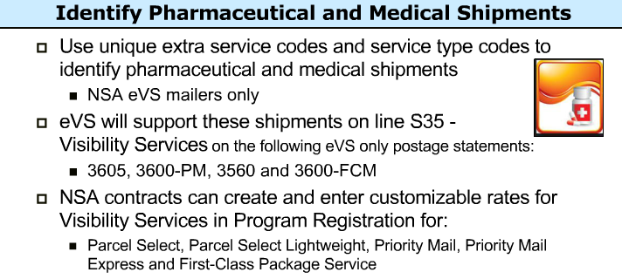
Changes by Class of Mail
Extra Services, Parcel Return Service & Mailer Services Changes Continued
Notes:
Read Slide

Slide 12
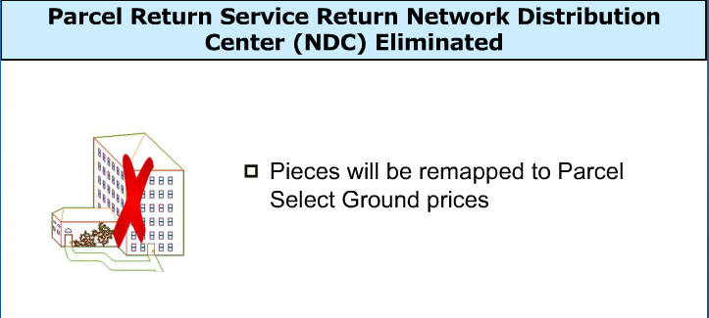
Changes by Class of Mail
Extra Services, Parcel Return Service & Mailer Services Changes Continued
Notes:
Read Slide

Slide 13
International Mail
International Mail Changes
Global Express Guaranteed (GXG) is the Postal Service’s premier international expedited product provided through an alliance with FedEx Express®The price increase for GXG service averages 7.1 percent
Customers who prepare GXG shipments via Click-N-Ship service will now pay retail prices
The Postal Service continues to offer Commercial Plus pricing for large volume customers
Priority Mail Express International with Money-Back Guarantee service is available for certain destinations. The price increase for Priority Mail Express International service averages 11.6 percent.

Slide 14
International Mail
International Mail Changes Continued
Discontinuing the Priority Mail Express International Flat Rate Box.
Priority Mail Express International flat rate pricing continues to be available for Flat Rate Envelopes.
The price increase for Priority Mail International service averages 10.2 percent. Customers who prepare Priority Mail International shipments via Click-N-Ship service will now pay retail prices.
First-Class Package International Service (FCPIS) is an economical international service for small packages weighing less than 4 pounds and not exceeding $400 in value.
Increase in price structure for International Priority Airmail and International Surface Air Lift.

Slide 15
Postage Statements
New postage statements associated with the January 2016 price change are available on Postal Explorer® at pe.usps.com.
As of January 17, 2016, the new January 2016 postage statements are required:
For Priority Mail® (PS Form 3600-PM)
First-Class Package Service® (PS Form 3600-FCM)
Parcel Select® (PS Form 3605-R)
International Mail (PS Form 3700).
When mailing Market Dominant (Mailing Services) products, mailers may continue to use the May 2015 statements until the next Market Dominant price change:
Standard Mail® PS Form 3602R
Standard Mail Nonprofit PS Form 3602N
First-Class Mail® PS Form 3600 FCM
Periodicals PS Form 3541)

Slide 16
Intelligent Mail Package Barcode
IMpb requirements are for all parcels entered through commercial channels including, but not limited to:
  Priority Mail ExpressTM
  Priority Mail®
  First-ClassTM Package Services
  Parcel Select
  Parcel Select Lightweight
  Postage paid by:
    Permit imprint
    Postage meter
    PC Postage®
    Precancelled stamps
    Franked Mail or Official Mail Accounting System

Slide 17
Intelligent Mail Package Barcode
Current Requirements
Use a unique IMpb on each mailpiece Prepared in accordance with DMM 708 Submit an electronic SSF, version 1.6 (or higher) Include the correct destination delivery address or ZIP+4 Code in the SSF Effective Jan 2015: Inclusion of 11-digit DPV Refer to SSF layout specifications in Publication 199 https://ribbs.usps.gov/intelligentmail_package/documents/tech_guides/PUB199IMPBImpGuide.pdf

Slide 18
Intelligent Mail Package Barcode
Coming in 2016: New IMpb Requirements
Mailers IMpb status will be available for review in January, 2016
  Assessments will begin July, 2016
In 2016, 3 new IMpb requirements will be implemented for commercial mailers
Barcode Quality: Readability and construction of Intelligent Mail package barcode (IMpb) on each mail piece
Manifest Quality: Validation of Shipping Services File (SSF), version 1.6 (or higher) for rate and payment fields
Address Quality: Verifying address or zip-11 is Delivery Point Validated (DPV)

Slide 19
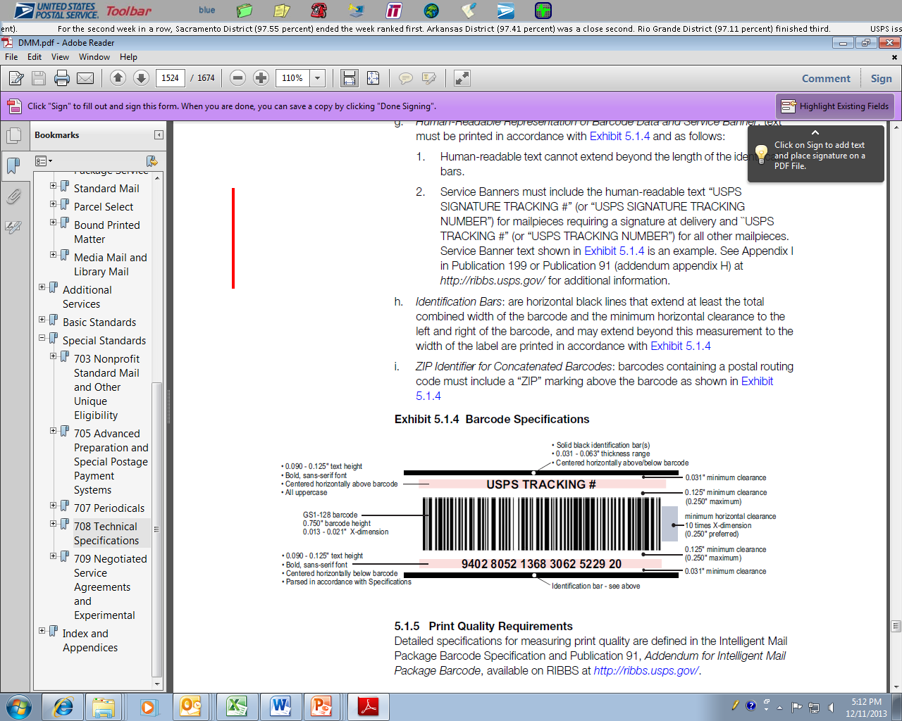
Intelligent Mail Package Barcode
Requirement to use a unique IMpb barcode prepared in accordance with DMM 708 (Standards for Package and Extra Service Barcodes: Intelligent Mail Package Barcode)

Slide 20
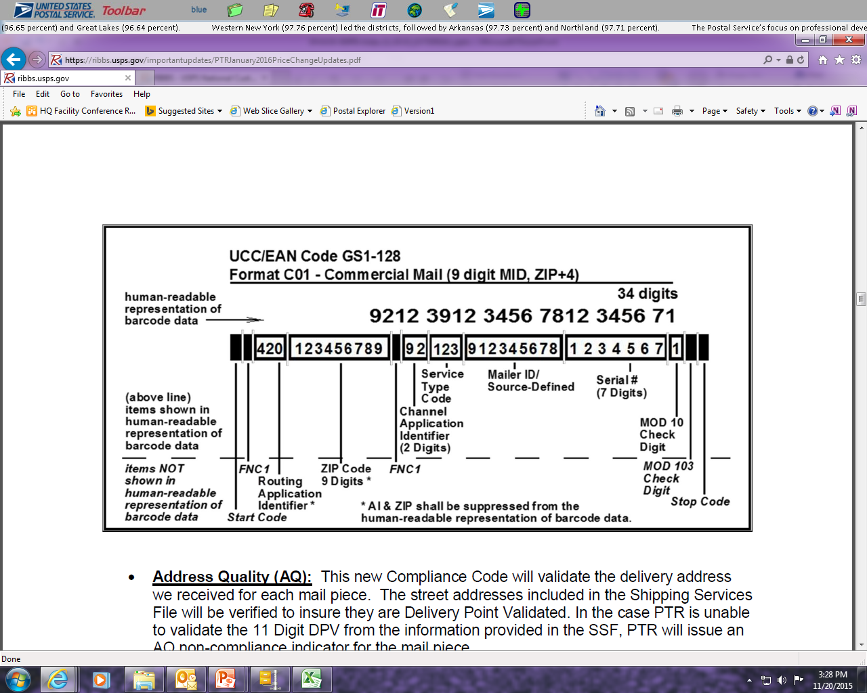
Intelligent Mail Package Barcode
IMpb Barcode Validation based on: -Barcode Uniqueness -Readability -Service Type Code -Mailer ID (Human-readable representation of barcode data)
Notes:
Read Slide

Slide 21
Intelligent Mail Package Barcode
IMpb Compliance Thresholds
The following compliance thresholds apply for the January 2016 Release
 | Compliance Category | January 2016
Current | Unique trackable barcode (legacy or IMpb) | 95%
Current | Destination delivery address or ZIP+4 in SSF | 98%
Current | Shipping Services File (legacy or v1.6 or higher), including required data elements | 96%
NEW! | Barcode Quality | 0%
NEW! | Address Quality | 0%
NEW! | Shipping Services File / Manifest Quality | 0%

Slide 22
Resources
There are several tools available to help mailers meet the IMpb and data submission requirements:
Use a certified vendor software solution
  See list on next slide; latest are posted on https://ribbs.usps.gov/evs
Use a certified consolidator solution
  See list on next slide; latest are posted on https://ribbs.usps.gov/evs
Become an eVS mailer
  Contact the eVS Help Desk at evs@usps.gov or 877-264-9693 (select option 3) for help signing up or for more information
Use the USPS Postal Shipping Tool
  Note: Additional information is available at https://gateway.usps.com under “Shipping Services”

Slide 23
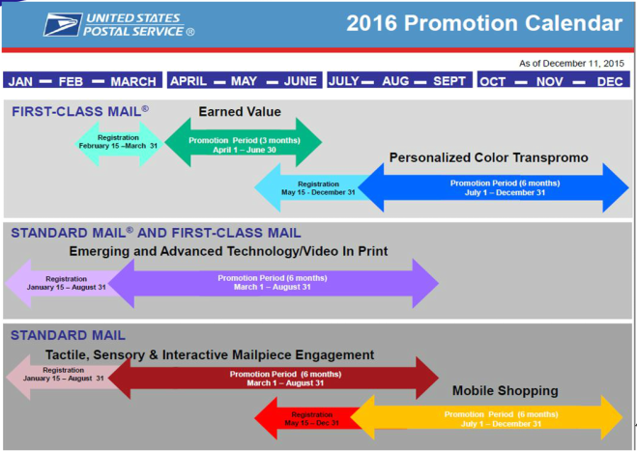
2016 Promotions

Slide 24
Resources
The Mail.dat 15-1 and 16-1, and Mail.XML 17-0 and 18.0 specifications for eDoc and Postage Statement Functionality and the Shipping Services File versions 1.6, 1.7 and 2.0 are impacted by the upcoming changes. Information on these and other rate changes can be found on our Rapid Information Bulletin Board at:
RIBBS.usps.gov
Or on our Postal Explorer website at:
pe.usps.gov

Slide 25

      Questions

