Slide 1
Political Campaign Mail and Official Election Mail 2016 Mailing Season
Notes:
Welcome to the Political Campaign and Official Election Mail webinar for the 2016 election cycle. This webinar will provide you with the information necessary to assist mail owners and Mail Service Providers with their political and election mail, as well as the information needed to accept, verify and turn the mail over to operations. Additional resources and points of contact are provided at the end to assist with follow-up questions.

Slide 2
Agenda
Political Campaign Mail
What is Political Campaign Mail?
How important is mail to a campaign?
6 reasons to use direct mail
7 rules of successful direct mail
Prepare Political Campaign Mail
Mail classes
Intelligent Mail Barcode (IMb) & Tracing
QR codes & emerging technologies
Incentives & Promotions
Postage Statement Changes
EDDM
Alternate Postage Program
Design Political Campaign Mailpiece
Submit Political Campaign Mailings for Acceptance
5 Ways to Submit Mail
Identifying Political Campaign Mail
Official Election Mail
What is Official Election Mail?
Prepare Official Election Mail
Mail classes
Postage Statement Changes
Mailing Standards
Intelligent Mail Barcode (IMb) & Tracing
AFO/APO Absentee Ballots
Requirements for Official Election Mail
Design Official Election Mailpiece
Publication 631
MDA Support
Submit Official Election Mailings for Acceptance
5 Ways to Submit Mail
Identifying Official Election Mail
Resources
Notes:
Let’s begin with an explanation of Political Campaign Mail.

Slide 3
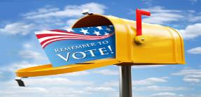
What is Political Campaign Mail?
Political Campaign Mail is mail created by a candidate or other Political Message organization and is presented at a BMEU or DMU then distributed prior to an election
The Political Campaign Mail definition is expanded to include:
Political Action Committees (PAC)
Super-PACs
Other organizations engaging in issue advocacy or voter mobilization
*All mailings presented by these Political Messaging Organizations are now eligible to use Tag 57 on their mailings
Notes:
Political Campaign Mail is mail created by a candidate or other Political Message organization. It can be presented at a Business Mail Entry Unit or Detached Mail Unit by a political candidate, political organization or mail service provider. In order to receive Non-profit prices for Standard Mail, these political message organizations must have applied and been approved for nonprofit status by the Postal Service.
The eligibility definition of Political Committees has been expanded to include any mailing that has any political content. This simplification includes mailings paid for by a candidate, a Political Action Committee (PAC) or a SUPERPAC, and other organizations engaging in issue advocacy or voter mobilization.

Slide 4
How Important is Mail to a Campaign?
Voters read mail!
79% of recipients at least scan their mail daily and 55% read it all
40% of 18- to 34-year-olds said they read mail immediately and find it useful
Political Mail offers unique marketing advantages:
Mail is BEST at targeting specific voters and telling a deeper story
Nearly ALL mailpieces are at least viewed
Mailpieces can be saved for future reference, taken to the polls, and shared with like-minded voters
Hit home with 100% of your electorate – USPS delivers to virtually every address in the U.S.
Customizable message to appeal to specific voter groups and swing voters – Emphasize the points that are most relevant to each voter and most likely to increase support for your candidate or cause
Mail helps to micro-target specific audiences
Notes:
The 2016 election is shaping up to be the most challenging yet for political campaigns across the country. The battles are heated. The marketing spend is high. And the media chatter is loud and constant. How can you communicate to voters about your candidate or proposal over all the noise? The answer: mail.
In 2012, 2.8 billion political mailpieces were sent at an average of less than 19 cents per piece in postage. In 2016, political mail will play just as BIG a role. Why? Because it brings advantages that few other marketing channels can match. Mail is best at targeting specific voters and telling a deeper story. Nearly ALL mailpieces are at least viewed. Mailpieces can be saved for future reference, taken to the polls, and shared with like-minded voters.
No other media channel is as flexible, targetable, and customizable as mail. USPS® delivers to virtually every address in the U.S., allowing you to directly reach your electorate with a message that is customizable to specific voter groups and swing voters.
Further, mail helps to micro-target specific audiences. Micro-targeting is the ability to target a group of voters by two or more variables. For example, certain mailpieces could target working women with children, rather than stay-at-home moms, by highlighting a candidate’s position
on child-care tax credits.

Slide 5
Six Reasons to Use Direct Mail
Direct Mail offers 6 key factors to help a political campaign.
Direct Mail is….
Targeted – focus your time on specific/targeted voters
Measurable – track responses
Tangible – people can hold it and save it
Powerful – personalized messaging & graphics
Flexible – unlimited formats
Cost-effective – as inexpensive as a postcard
Marketing firm TM Direct recently used direct mail to raise $50 million for a 2016 presidential candidate!
Notes:
A political campaign is like a business in that it is striving to win over as much of its voter “market” as it can with limited resources.
Direct Mail offers six key factors to help you. Mail is:
Targeted. Target voters by variables such as household income, gender, and geographic location. And focus your
media dollars on the people most likely to be influenced by your message.
Mail is Measurable. Track responses to fund-raising solicitations and surveys, and learn what works and what doesn’t. Then apply that knowledge to future mailings to continuously improve your response rate.
Mail is Tangible. People can hold mail, spend time with it, and save it. Many people refer to mailings while they fill out their absentee ballots.
Mail is Powerful. Create powerful mailpieces with personalized messaging and graphics. Or include an interactive device such as a QR Code, SnapTag, or PURL to drive voters to your website. These technologies are explained in more detail later in this presentation.
Mail is also Flexible. Unlimited formats are available to meet any budget, deadline, or objective.
Finally, mail is Cost-effective. Mail concentrates on a specific target, and the format can be as inexpensive as a postcard.

Slide 6
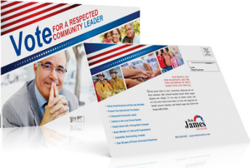
Seven Rules of Successful Direct Mail
Direct Mail offers 7 guidelines for a successful political campaign:
Let your visuals do most of the talking
Create a “scannable” mailpiece
Keep it simple!
Make sure the layout flows
Ensure it is relevant
Add footnotes for credibility
Time the mailing for the best response
Notes:
Let your visuals do most of the talking – the visual element engages people and gets their attention
Create a “scannable” mailpiece – voters should be able to visually scan the mailpiece and understand the message. Use plenty of white space, visuals, and bulleted copy.
Keep it simple! – 2 or 3 major points are more likely to be remembered than a half dozen
Make sure the layout flows – people generally look at a page from left to right, top to bottom. Your layout should follow the same flow.
Ensure it is relevant – when the message is relevant, it’s automatically engaging. Craft the message so it addresses the specific concerns of the target
Add footnotes for credibility – quotes or statistics add power to a political mailpiece. Be sure to include footnotes to give these statements credibility
Time the mailing for the best response – time mailings to coincide with a candidate’s speaking engagement, a TV campaign, or right before the election for the greatest success.

Slide 7
Agenda
Political Campaign Mail
What is Political Campaign Mail?
How important is mail to a campaign?
6 reasons to use direct mail
7 rules of successful direct mail
Prepare Political Campaign Mail
Mail classes
Intelligent Mail Barcode (IMb) & Tracing
QR codes & emerging technologies
Incentives & Promotions
Postage Statement Changes
EDDM
Alternate Postage Program
Design Political Campaign Mailpiece
Submit Political Campaign Mailings for Acceptance
5 Ways to Submit Mail
Identifying Political Campaign Mail
Official Election Mail
What is Official Election Mail?
Prepare Official Election Mail
Mail classes
Postage Statement Changes
Mailing Standards
Intelligent Mail Barcode (IMb) & Tracing
AFO/APO Absentee Ballots
Requirements for Official Election Mail
Design Official Election Mailpiece
Publication 631
MDA Support
Submit Official Election Mailings for Acceptance
5 Ways to Submit Mail
Identifying Official Election Mail
Resources
Notes:
Let’s begin with an explanation of Political Campaign Mail.

Slide 8
Mail Classes for Political Campaign Mail
Ways to send PCM
First-Class Mail: use for personalized letters, fundraising invitations, or any communications with a personal touch
Standard Mail: ideal for sending postcards, printed flyers, advertisements, or newsletters
Every Door Direct Mail: allows you to mail to entire routes, as opposed to individual addresses
Target entire cities, ZIP Codes, neighborhoods, or individual mail routes

Slide 9
BME Roles
Intelligent Mail barcode (IMb)
Intelligent Mail barcode (IMb) is used to sort and provide visibility on letters and flats
Ability to identify individual mailpieces
Offers the potential to combine multiple services using one barcode
IMb is a requirement of Full-Service, which provides:
Additional per-piece discount
Waiver of annual mailing fees
Free address correction
Ability to participate in Mail Anywhere
Ability to participate in Promotions and Incentive programs
Feedback on mail quality
Visibility into mailings
Notes:
Intelligent Mail barcode (IMb) is used to sort and provide visibility on letters and flats. It provides the ability to identify individual mailpieces and offers the potential to combine multiple services using one barcode. IMb is a requirement of Full-Service, which provides several benefits to mailers, including an additional per-piece discount, waiver of annual mailing fees, free address correction, the ability to participate in Mail Anywhere, the ability to participate in Promotions and Incentive programs, feedback on mail quality, and greater visibility into mailings.

Slide 10
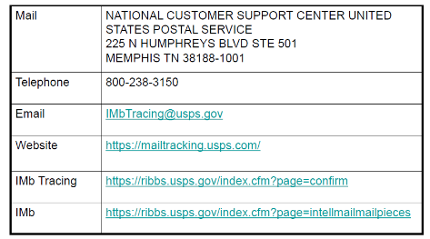
BME Roles
Intelligent Mail barcode (IMb) Tracing
IMb Tracing provides near real-time tracking information for automation-compatible letters and flats
Offers advance notice for both incoming and outgoing mail
First-Class Mail, Periodicals, and Standard Mail flats with Intelligent Mail barcodes eligible to participate in IMb Tracing
To learn more or get started with IMb Tracing™, visit our website or contact our customer support center
Notes:
IMb Tracing provides near real-time tracking information for automation-compatible letters and flats. It offers advance notice for both incoming and outgoing mail. First-Class Mail, Periodicals, and Standard Mail flats with Intelligent Mail barcodes eligible to participate in IMb Tracing. To learn more or get started with IMb Tracing™, visit our website or contact our customer support center using any of the contact methods shown here.

Slide 11
QR Codes & Emerging Technologies
QR Code: Provides quick access to websites & online media
Much less expensive than broadcast media
SnapTags: Works like QR codes, but logo can be custom-designed
PURL’s: A URL personalized for each website user
Works with or without smartphones
Used to track and gather data
Augmented Reality: Turns information on mailpiece into a virtual experience by interaction with recipient’s webcam
mailPOW: Turns mail into a sound bite by producing Direct Mail with a voice chip

Slide 13
2016 Promotions & Incentives
Earned Value Promotion:
Credit on qualifying BRM/CRM reply pieces; can be applied to postage for future mailings
First-Class Mail only
Personalized Color Transpromo Promotion:
Color message must either address recipient by name or contain information specific to the recipient
First-Class Mail only
Emerging and Advanced Technology/Video in Print Promotion:
First-Class Mail and Standard Mail
A/B testing option allows mailers to test customer response rates to mailpieces with or without qualifying technology
Notes:
The Postal Service offers various Promotions and Incentives throughout the year. Mailings must meet certain criteria to qualify for either a credit or discount based upon the type of promotion or incentive selected.
The Earned Value Promotion: This program will run from April through June 2016. This promotion is available for First-Class Mail® only, and builds on the success of previous years promotions. The promotion is in the form of a credit on qualifying BRM/CRM reply pieces; which can then be applied to postage for future mailings.
The Personalized Color Transpromo Promotion: This promotion will run from July through December 2016. Similar to the program in 2015, this promotion is only available for First-Class Mail. Added this year is the requirement that the color message must either address the recipient by name or contain information relevant and specific to the recipient.
The Emerging and Advanced Technology/Video in Print Promotion: The program will run from March through August 2016. As with the program in 2015, this promotion is available for both First-Class Mail and Standard Mail®. Added this year is an A/B testing option, which allows mailers to test customer response rates to mailpieces featuring the qualifying technology compared to customer response rates to mailpieces without the qualifying technology.

Slide 14
2016 Promotions & Incentives
Tactile, Sensory and Interactive Mailpiece Engagement Promotion:
Advanced print innovations distinct from more digitally focused technologies
Standard Mail only
Mobile Shopping Promotion:
Integrate mobile technology into their direct mail during the 2016 holiday season
Standard Mail only
Visit the Business Customer Gateway to register for promotions and incentives separately
Notes:
The Tactile, Sensory and Interactive Mailpiece Engagement Promotion: This program will run from March through August 2016. The USPS recognizes that advanced print innovations are distinct from the more digitally focused technologies addressed by the Emerging and Advanced Technology/Video in Print Promotion, so this is offered as its own promotion for 2016. This promotion is available only for Standard Mail.
The Mobile Shopping Promotion: This promotion will run from July through December 2016. As in prior years, this promotion encourages mailers to integrate mobile technology into their direct mail during the 2016 holiday season. This promotion is available only for Standard Mail.
Visit the Business Customer Gateway to register for promotions and incentives.

Slide 15
Promotions Sampling
USPS randomly samples mailpieces to ensure mailing meets qualifications for requested Promotion
Option 1
Option 2
Pre-mailing event
Submit pre-print/input sheet
Dynamic print versions,
Lists of BMEUs
3 weeks prior to mailing
Time of mailing
Submit hardcopy sample of unaddressed mailpiece to BMEU/DMU
BMEU will maintain a file in the office which includes:
Sample mailpiece
Copy of the PS Form 3607
Notes:
We have made changes to the way samples will be collected and recorded during the 2016 Promotions period. The instructions will be found in the User Guide for each promotion. User Guides are found on the RIBBS website.
To verify eligibility for a Promotion, the USPS randomly samples mailpieces to ensure the mailing meets the qualifications for the requested Promotion and/or Incentive. The USPS is offering two options to submit samples to the Program Office for review. The Program Office will specify which sample process will apply to each promotion.
Option 1 the PRE-mailing event. Mailers who use the same messaging with limited variations throughout the promotion period may send samples of the pre-print/input sheet as well as samples of the dynamic print versions to the USPS Promotions program office. Samples must be submitted at least three weeks in advance of the initial mailing. The mailer will also submit a list of all BMEUs that will be used for mail entry throughout the promotion must be provided to the Program Office. After a review process is completed the Program Office will notify both the mailer and the BMEU whether or not a sample has been pre-approved.
Option 2 occurs at the time of mailing. Just as many do today, a Mailer will submit a hardcopy sample of an unaddressed mailpiece to the BMEU/DMU when they present a mailing for acceptance at a BMEU or DMU. Each BMEU where mail is presented will maintain a file in the office which includes the sample mailpiece and a copy of the PS Form 3607 for the Job. This sample mailpiece may be randomly selected for review by the Promotions Program Office.
This is what is different about the new sampling process. If a mailer is presenting a sample for a mailing that was printed all at once, in other words, one time, the USPS will require that the mailer only submit 1 sample mailpiece. Today, even if a mailing was printed all at once we require a mailer to present a sample mailpiece each time they submitted a mailing. HOWEVER, if mailings are printed at different times, although the mailpiece is essentially the same, a sample mailpiece must be produced each time. This applies to each Business Mail Entry Unit where our customer enters the mail.

Slide 16
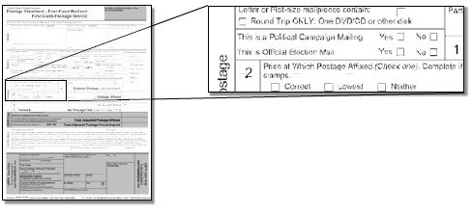
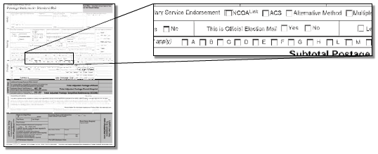
Postage Statements Changes
Beginning in 2014, USPS enabled an OEM / PCM checkboxes on PS Forms 3602R & N, 3600PM, 3600FCM
PS Form 3600-FCM, Postage Statement—First-Class Mail and First-Class
Package Service
Only one “Yes” can be selected
PS Form 3602-R1, Postage Statement - Standard Mail
Notes:
Effective January 26, 2014, the USPS enabled checkboxes in PostalOne!® processing and the following Postage Statements 3602R & N for Standard Mail, 3600 Priority Mail, and 3600 First-Class Mail to signify when a mailing should be considered as Political Campaign Mail or Official Election Mail. Note that Political Campaign Mail and Official Election Mail cannot be mixed on a postage statement—whether hardcopy or eDoc. For example, in order to claim Official Election Mail, all pieces on a statement must claim Official Election Mail without claiming any Political Campaign Mail—and vice versa. The mailings must be paid for on separate statements. OMAS Imprint (OI) and OMAS Metered (OM) permits cannot be used to pay for Political Campaign Mail or Official Election Mail.
Based on a mailer’s eDoc submission, PostalOne! will prepopulate radio buttons indicating Yes or No for “This is a Political Mailing” and “This is Official Election Mail.” If Yes is selected for either radio button, acceptance employees can tag the mailing with the corresponding tag: either a Green Tag 191 or Red Tag 57. Once tagged, the mailing must be recorded on the Log for Political Campaign Mail/Official Election Mail. For hardcopy statements, acceptance employees must physically check the appropriate box.
Mailers that submit Mail.dat and/or Mail.XML eDocs without Political Campaign Mail or Official Election Mail indicators are acknowledging the mailing does not contain Political Campaign or Official Election mail. The appropriate radio button, indicating a No, will be visible to the BMEU acceptance employee during statement finalization. If No is selected, then the mailing cannot be tagged with either 191 or 57, and the BMEU acceptance employee will not log the mailing as Political Campaign Mail or Official Election Mail.
However IF, upon review of the mailing, the BMEU determines that it does consist entirely of Political Campaign Mail or Official Election Mail, then the acceptance employee should change the selection from No to Yes.

Slide 17
Postage Statements Changes
Mailings submitted using the Every Door Direct Mail (EDDM) Tool are a special case because there is no Political Campaign Mail or Official Election Mail fields to select
When a mailing is submitted using this tool both check boxes will automatically be populated as No in PostalOne!
BMEU employees may modify these values during acceptance if needed
Notes:
Mailings submitted using the EDDM Tool are a special case. There are no fields in the EDDM Tool for mailers to select Political Campaign and/or Official Election Mail. When a mailing is submitted using this tool, both check boxes will automatically be populated as No in PostalOne!. Acceptance employees can then modify the selections if necessary.
It is important to note that when we discuss EDDM mail in conjunction with Political Campaign Mail, we are referring to EDDM mail entered at an acceptance unit and not at Retail.

Slide 18
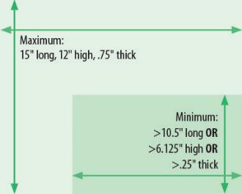
Every Door Direct Mail
BME Roles
Every Door Direct Mail® (EDDM) allows a mailer to saturate an entire neighborhood with their message by getting the mailing directly into the homes and hands of potential voters
EDDM can be used for Political Campaign Mail
How does it work?
Contact the EDDM Helpdesk at 877-747-6249 for more information
The mailer picks the neighborhoods they want to reach and a Postal Service Letter Carrier takes the pieces to every home while delivering the day’s mail
Rules for Every Door Direct Mail Political Campaign Mailers
Notes:
To clarify, Political Campaign Mail may be submitted to a BMEU using Every Door Direct Mail or EDDM. EDDM mail allows a mailer to target a specific geographic area, thereby getting specific political information into the right homes. The Mailer must first pick the neighborhoods they want to reach and a Postal Service Letter Carrier takes the pieces to every home while delivering the day’s mail.
The same rules that apply to all EDDM commercial mailings apply to Political Campaign Mailings entered using EDDM. The mailpiece must be more than 10 1/2 inches in length OR more than 6 1/8 inches in height OR more than 1/4-inch thick. It cannot be more than 15 inches in length OR 12 inches in height OR 3/4-inch thick.
With further questions about EDDM, please contact the EDDM Helpdesk at 877-747-6249.

Slide 19
Alternate Postage Program
Business sends customer a promotion that includes Alternate Postage mailers.
Customer sends (prepaid) Alternate Postage pieces to his/her friends.
Friends receive mailer & respond online or in-store for any industry.
What mailers do:
Send from multiple U.S. locations to multiple U.S. locations
Postage already paid
Include brand or logo
What mailers get:
Social network-like experience for customers through mail
Control over your messaging
What to include:
3 elements on each mailpiece:
Facing Identification Mark (FIM)
Permit Imprint Indicia or Picture Imprint Indicia
Intelligent Mail barcode (IMb)

Slide 20
Agenda
Political Campaign Mail
What is Political Campaign Mail?
How important is mail to a campaign?
6 reasons to use direct mail
7 rules of successful direct mail
Prepare Political Campaign Mail
Mail classes
Intelligent Mail Barcode (IMb) & Tracing
QR codes & emerging technologies
Incentives & Promotions
Postage Statement Changes
EDDM
Alternate Postage Program
Design Political Campaign Mailpiece
Submit Political Campaign Mailings for Acceptance
5 Ways to Submit Mail
Identifying Political Campaign Mail
Official Election Mail
What is Official Election Mail?
Prepare Official Election Mail
Mail classes
Postage Statement Changes
Mailing Standards
Intelligent Mail Barcode (IMb) & Tracing
AFO/APO Absentee Ballots
Requirements for Official Election Mail
Design Official Election Mailpiece
Publication 631
MDA Support
Submit Official Election Mailings for Acceptance
5 Ways to Submit Mail
Identifying Official Election Mail
Resources
Notes:
Let’s begin with an explanation of Political Campaign Mail.

Slide 21
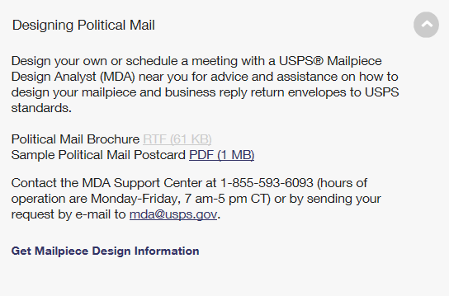
Design Political Mail
PLAN: Determine which mail service to use and the best way to get return mail
ADDRESS: Ensure election mail is addressed properly and your lists are up-to-date
DESIGN: Design mailpiece and business reply return envelopes to USPS standards
Contact a Mailpiece Design Analyst for additional support
https://www.usps.com/business/political-mail.htm
Notes:
On‐line help is available through USPS.COM at the link shown here. From this site, you can learn more about planning, addressing, and
designing political mail, get help from an expert and much more.

Slide 22
Agenda
Political Campaign Mail
What is Political Campaign Mail?
How important is mail to a campaign?
6 reasons to use direct mail
7 rules of successful direct mail
Prepare Political Campaign Mail
Mail classes
Intelligent Mail Barcode (IMb) & Tracing
QR codes & emerging technologies
Incentives & Promotions
Postage Statement Changes
EDDM
Alternate Postage Program
Design Political Campaign Mailpiece
Submit Political Campaign Mailings for Acceptance
5 Ways to Submit Mail
Identifying Political Campaign Mail
Official Election Mail
What is Official Election Mail?
Prepare Official Election Mail
Mail classes
Postage Statement Changes
Mailing Standards
Intelligent Mail Barcode (IMb) & Tracing
AFO/APO Absentee Ballots
Requirements for Official Election Mail
Design Official Election Mailpiece
Publication 631
MDA Support
Submit Official Election Mailings for Acceptance
5 Ways to Submit Mail
Identifying Official Election Mail
Resources
Notes:
Let’s begin with an explanation of Political Campaign Mail.

Slide 23
Five Ways to Submit Mail
There are 5 ways that mailers can submit mail:
Certified Vendors List on RIBBS: https://ribbs.usps.gov/uniqueimb/documents/tech_guides/VendorFullServiceCapabilities.pdf
Mail.XML™
Intelligent Mail Small Business Tool (IMsb)
Postal Wizard
Mail.dat
BMEU Hardcopy Postage Statement
eDoc Submission Methods
Notes:
There are 5 ways that mailers can submit mail: the first is by hardcopy postage statement, and the other four utilize electronic documentation, or eDoc. eDocs can be submitted through the following methods:
Mail.dat allows the mailer to use their own software or vender software to create electronic files. Mail.dat is an electronic file that represents the mailing, contains the Postage Statement and qualification information, and uses a fixed file format to send mailing information.
Mail.XML™ allows the mailer to use their own software or vendor software to create electronic files. Mail.XML™ is an electronic message that represents the mailing, and contains the Postage Statement and qualification information. Mail.XML™ allows two-way conversational communication between USPS and the mailer’s submission systems, letting the customer select and correct data fields submitted.
Postal Wizard is a USPS tool that allows the mailer to type information into an online form that creates an electronic postage statement. Separate software is needed to generate barcodes.
The Intelligent Mail Small Business Tool (IMsb) is a web-based tool for creating Full-Service mailings. The IMsb prints an IMb on pieces and tray labels, and creates a Full-Service electronic postage statement which serves as the electronic documentation, or eDoc. This tool can be used to create mailings of less than 10,000 pieces and is limited to an annual volume of less than 250,000 pieces. You can contact your local small business tool coordinator by contacting your local MBME, or Manager of Business Mail Entry.
Access to the PostalOne! system is required to submit electronic documentation using any of the methods listed above. In the coming slides we will review how your mailer submits electronic documentation using each of these methods. This information is provided so you can assist the mailer through the process, if needed.

Slide 24
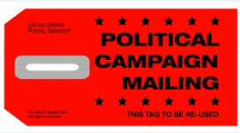
Identifying Political Campaign Mail
Mailers must use the Red PS Tag 57, Political Campaign Mailing, to identify trays and sacks that contain Political Campaign Mail
Eligible mailings include:
Registered political candidates and their associated campaign committees
Political party committees
Political message mailings by Political Action Committees, Surplus PACs, or other organizations that engage in issue advocacy or voter mobilization
Notes:
BMEUs and DMUs will supply the red Tag 57 Political Campaign Mailing for all eligible mailings to identify trays and sacks that contain Political Campaign Mail. Tag 57 must be attached to First-Class Mail and Standard Mail mailing containers.
All political mailings presented by registered political candidates and their associated campaign committees, political party committees, or political message mailings by Political Action Committees, Super PACs or other organizations that engage in issue advocacy or voter mobilization are now eligible to use Tag 57 on their mailings. If a mailing has any political content, it qualifies to use Tag 57. Consider the following examples:
An organization mails a monthly newsletter with 10 articles in it. If one article references a political topic, the mailing qualifies to have TAG 57 attached.
Joe’s Hardware Store mails a monthly advertisement of hardware specials. The current advertisement includes a note that Joe supports Mary Hill for County Commissioner. This mailing qualifies to use Tag 57.
Wal-Mart places a note on its flier that says, ‘Vote on November 4’. This mailing qualifies to have a Tag 57.
Regardless of who pays for the mailing, Political Campaign Mail is eligible to use Tag 57 Political Mail tags. When using Tag 57, the mailing must be recorded on the Log for Political Campaign Mail/Official Election Mail that is maintained in acceptance units. We will discuss the log in more detail later in the presentation.

Slide 25
Agenda
Political Campaign Mail
What is Political Campaign Mail?
How important is mail to a campaign?
6 reasons to use direct mail
7 rules of successful direct mail
Prepare Political Campaign Mail
Mail classes
Intelligent Mail Barcode (IMb) & Tracing
QR codes & emerging technologies
Incentives & Promotions
Postage Statement Changes
EDDM
Alternate Postage Program
Design Political Campaign Mailpiece
Submit Political Campaign Mailings for Acceptance
5 Ways to Submit Mail
Identifying Political Campaign Mail
Official Election Mail
What is Official Election Mail?
Prepare Official Election Mail
Mail classes
Postage Statement Changes
Mailing Standards
Intelligent Mail Barcode (IMb) & Tracing
AFO/APO Absentee Ballots
Requirements for Official Election Mail
Design Official Election Mailpiece
Publication 631
MDA Support
Submit Official Election Mailings for Acceptance
5 Ways to Submit Mail
Identifying Official Election Mail
Resources
Notes:
Let’s begin with an explanation of Political Campaign Mail.

Slide 26
What is Official Election Mail?
Official Election Mail is any mailing created by an authorized voting registration official mailed to a U.S. citizen for the purpose of voting
These include:
Mail-In Ballots
Absentee Ballots
Ballot Materials
Voter Registration Cards
Absentee Applications
Polling Place Notifications
Official Election Mail™ logo can be used on all classes of mail and all processing categories
Notes:
Official Election Mail is mail created by an authorized voting registration official and sent to or from citizens of the United States for the purpose of participating in the voting process. Included in this category are Mail-In Ballots, Absentee Ballots, and related ballot materials, Voter Registration Cards, Absentee Voting Applications and Polling Place notifications. The Official Election Mail checkbox in PostalOne! must be checked for all mailings of these types of materials.
Note that election mail does not include Political Campaign Mail. These are separate and distinct categories, and there are no circumstances under which a mailing can qualify as both.
The Official Election Mail™ logo, shown here, is a unique registered trademark designed exclusively for inclusion in the design of Official Election Mail. The logo design features an interpretation of the stars and stripes of the American flag, and the words “Official Election Mail,” clearly visible over the designation — “Authorized by the U.S. Postal Service.” Correct usage of the logo by election officials helps to ensure the intent and credibility of this symbol remain intact.
The Official Election Mail logo can be used on any mailpiece created by an election official that is mailed to or from a citizen of the United States for the purpose of participating in the voting process. This includes balloting materials, voter registration cards, absentee applications, polling place notifications, and voter reply mail. The logo can be used on all classes of mail and all processing categories however, it is not intended to
upgrade service or substitute for postage. More information about the logo is included later in the presentation.

Slide 27
Agenda
Political Campaign Mail
What is Political Campaign Mail?
How important is mail to a campaign?
6 reasons to use direct mail
7 rules of successful direct mail
Prepare Political Campaign Mail
Mail classes
Intelligent Mail Barcode (IMb) & Tracing
QR codes & emerging technologies
Incentives & Promotions
Postage Statement Changes
EDDM
Alternate Postage Program
Design Political Campaign Mailpiece
Submit Political Campaign Mailings for Acceptance
5 Ways to Submit Mail
Identifying Political Campaign Mail
Official Election Mail
What is Official Election Mail?
Prepare Official Election Mail
Mail classes
Postage Statement Changes
Mailing Standards
Intelligent Mail Barcode (IMb) & Tracing
AFO/APO Absentee Ballots
Requirements for Official Election Mail
Design Official Election Mailpiece
Publication 631
MDA Support
Submit Official Election Mailings for Acceptance
5 Ways to Submit Mail
Identifying Official Election Mail
Resources
Notes:
Let’s begin with an explanation of Political Campaign Mail.

Slide 28
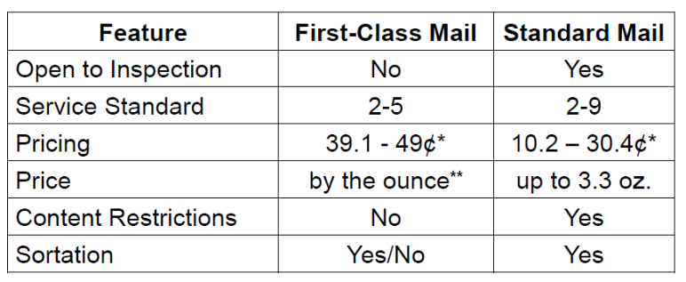
Mail Classes for Official Election Mail
* 2015 Prices
** For presorted First-Class Mail letters, the 2nd oz is free

Slide 29
Postage Statements Changes
Beginning in 2014, USPS enabled an OEM / PCM checkboxes on PS Forms 3602R & N, 3600PM, 3600FCM
PS Form 3600-FCM, Postage Statement—First-Class Mail and First-Class
Package Service
PS Form 3602-R1, Postage Statement - Standard Mail
Notes:
The Postal Service™ is committed to improving election mail processes. As mentioned previously, effective January 26, 2014, the USPS enabled an Election Mail Checkbox in PostalOne!® processing and the following Postage Statements 3602R & N for Standard Mail, 3600 Priority Mail, and 3600 First-Class Mail. The purpose of this change is to provide USPS visibility of all Official Election Mail entered into the mailstream. Please check the “This is Official Election Mail” box for each mailing presented for acceptance. This will provide the USPS insight regarding election mail volume by entry point that may help the USPS with future capacity planning.

Slide 30
Mailing Standards
Official Election Ballot mailpieces sent to and returned by voters must have full postage paid
DMM requires all balloting materials to indicate the proper amount of First-Class Mail postage that must be paid
There are four exceptions to this requirement:
The balloting materials are qualified under the special exemption for military and overseas voting
The ballot is returned under Business Reply Mail® service
Return postage is guaranteed through a postage due account
Postage on the ballot is prepaid by stamps, meter, or Permit Reply Mail
Mailers who submit Election Ballot mailings that are noncompliant with current return postage requirements can request a one-time-exception to MBME
Notes:
The number of ballots mailed back to election officials with insufficient postage is on the rise. Each election cycle presents a different set of parameters for ballot creation and for the size and weight of the return mailpiece. As a result, many voters do not know the correct amount of
postage required to return their ballot by mail. Election officials should consult with Postal officials to determine the proper amount of postage required for mailing ballots to voters and the return of ballots to election officials.
Effective October 7, 2013, the Postal Service™ revised the Mailing Standards of the United States Postal Service, Domestic Mail Manual 703.8 requiring that the balloting materials for all types of ballots, whether disseminated in hardcopy or electronically, must indicate in a prominent location the proper amount of First-Class Mail® postage that must be paid. This information must be included in the balloting materials (i.e., on the ballot, ballot instructions, mailing instructions, or the envelope) with the marking “First-Class Mail postage must be applied.” Alternatively, the marking “Apply First-Class Mail postage here” could be printed in the upper right corner of the address side of the envelope used by the voter to return the ballot to election officials. The Postal Service will also accept approved variations of the above markings.
The marking requirements will not apply to balloting materials that meet one of the following exceptions:
1) The balloting materials are qualified under the special exemption for military and overseas voting.
2) The ballot is returned under Business Reply Mail® service.
3) Return postage is guaranteed through a postage due account.
4) Postage on the ballot is prepaid by stamps, meter, or Permit Reply Mail.
Mailers who submit Election Ballot mailings that are noncompliant with current return postage requirements can submit a written request to the manager, Business Mail Entry, for a one-time-exception to allow the mailing to be accepted. The exception request will be forwarded to the Pricing and Classification Service Center for consideration.

Slide 31
BME Roles
Intelligent Mail barcode (IMb) & Tracing
Intelligent Mail barcode (IMb) is used to sort and provide visibility on letters and flats
Ability to identify individual mailpieces
Offers the potential to combine multiple services using one barcode
IMb Tracing provides near real-time tracking information for automation-compatible letters and flats
Offers advance notice for both incoming and outgoing mail
First-Class Mail, Periodicals, and Standard Mail flats with Intelligent Mail barcodes eligible to participate in IMb Tracing
http://mailtracking.usps.com
Notes:
Intelligent Mail barcode (IMb) is used to sort and provide visibility on letters and flats. It provides the ability to identify individual mailpieces and offers the potential to combine multiple services using one barcode. IMb Tracing provides near real-time tracking information for automation-compatible letters and flats. It offers advance notice for both incoming and outgoing mail. First-Class Mail, Periodicals, and Standard Mail flats with Intelligent Mail barcodes eligible to participate in IMb Tracing.

Slide 32
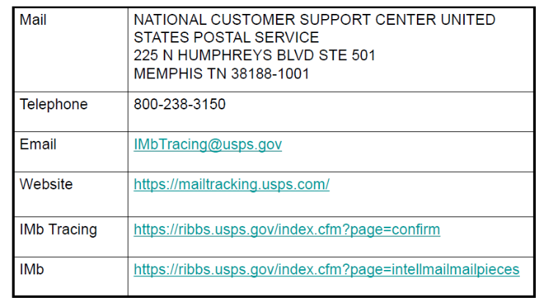
BME Roles
Intelligent Mail barcode (IMb) & Tracing
How do I get started with IMb Tracing™?
To learn more or get started with IMb Tracing™, visit our website or contact our customer support center
Notes:
To learn more or get started with IMb Tracing™, visit our website or contact our customer support center using any of the contact methods shown here.

Slide 33
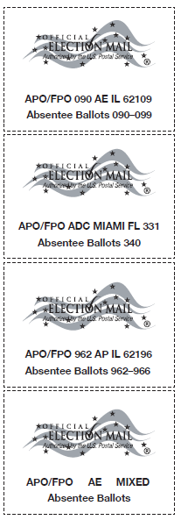
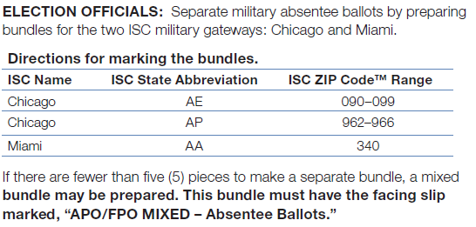
APO/FPO Absentee Ballots
Election officials should mail absentee ballots at least 45 days prior November 8, 2016, Mid-Term Election
Local election offices are requested to segregate military absentee ballots to:
Chicago International/Military Service Center Gateway
Miami International Service Center
Notes:
The Postal Service and the Military Postal Service have again joined forces to expedite delivery of absentee ballots to overseas military personnel. We recognize the important role mail plays in the election process and are committed to ensuring that everyone who votes by mail experiences a smooth, well-organized process — one that provides them with the highest level of trust and confidence. Special Procedures for APO/FPO Absentee Ballots are provided for Election Officials and Postal employees.
Here is a summary of the program:
■■ Election officials should mail absentee ballots at least 45 days prior to the November 8, 2016, Mid-Term Election.
All military absentee ballots mailed by election officials from September 1 through November 8,
2016, will be subject to special handling procedures.
■■ Local election offices are requested to segregate military absentee ballots to the Chicago International/Military Service Center (ISC) gateway and the Miami International Service Center.
■■ Trays or containers of absentee ballot mail may be identified using Tag 191, Domestic and International Ballots, and presented to the Post Office™.
■■ Contact your local Post Office for more information on standard procedures for election offices.
■■ APO/FPO absentee ballots will be sent from local Post Office locations to the nearest Processing & Distribution Center for further processing.
■■ At the International Service Centers, absentee ballots receive special handling.

Slide 34
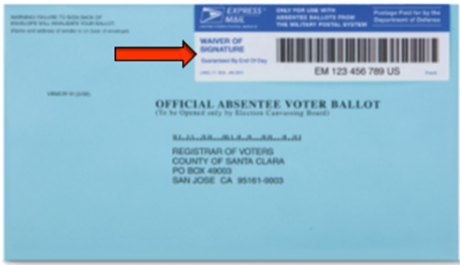
APO/FPO Absentee Ballots
Joint effort by USPS and Military Postal Service Agency in response to Military Overseas Empowerment (MOVE) Act
Military personnel in APO/FPO locations can now return absentee ballots via EM Label 11-DOD
Notes:
The APO/FPO Express Mail Label EM 11-DOD program was established via a joint effort by the USPS and Military Postal Service Agencies in response to Military Overseas Empowerment Act (MOVE). Military personnel in APO/FPO locations can now return absentee ballots via EM Label 11-DOD. Unique label to be used only for absentee ballots originating from overseas military postal locations. Military Postal Service will distribute labels to overseas destinations for use with voted ballots. Ballots will be returned via the International Service Centers and remain in the Express Mail stream until they are delivered. “Waiver of Signature” and “Guaranteed by End of Day” are printed on the label.

Slide 35
Agenda
Political Campaign Mail
What is Political Campaign Mail?
How important is mail to a campaign?
6 reasons to use direct mail
7 rules of successful direct mail
Prepare Political Campaign Mail
Mail classes
Intelligent Mail Barcode (IMb) & Tracing
QR codes & emerging technologies
Incentives & Promotions
Postage Statement Changes
EDDM
Alternate Postage Program
Design Political Campaign Mailpiece
Submit Political Campaign Mailings for Acceptance
5 Ways to Submit Mail
Identifying Political Campaign Mail
Official Election Mail
What is Official Election Mail?
Prepare Official Election Mail
Mail classes
Postage Statement Changes
Mailing Standards
Intelligent Mail Barcode (IMb) & Tracing
AFO/APO Absentee Ballots
Requirements for Official Election Mail
Design Official Election Mailpiece
Publication 631
MDA Support
Submit Official Election Mailings for Acceptance
5 Ways to Submit Mail
Identifying Official Election Mail
Resources
Notes:
Let’s begin with an explanation of Political Campaign Mail.

Slide 36
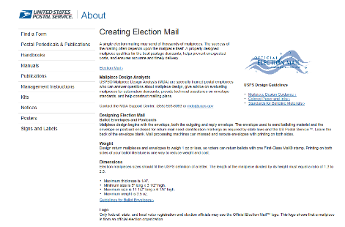
Design Election Mail
PLAN: Determine which mail service to use and the best way to get return mail
ADDRESS: Ensure election mail is addressed properly and your lists are up-to-date
DESIGN: Design mailpiece and business reply return envelopes to USPS standards
Contact a Mailpiece Design Analyst for additional support
https://about.usps.com/election-mail/creating-election-mail.htm
Notes:
When designing an election mail mailpiece, first start by determining which mail service (First-Class, Standard and Non Profit if eligible for Outgoing and BRM or CRM for Incoming) to use and the best way to get return mail. Then, ensure election mail is addressed properly and mailing lists are up-to-date. Then design the mailpiece and business reply return envelopes according to USPS standards. For additional support, contact a mailpiece design analyst or MDA at the address shown here. The following pages provide more details on designing official election mail.

Slide 37
Election Mailpiece Design: Support
Work with Mailpiece Design Analyst (MDA)
Verify ZIP+4 & Barcode
Logo placement
Endorsements
Size, shape, weight
Barcode clearances
Review before printing
MDA Support Center
Monday – Friday
7 am-5 pm CT
855-593-6093 mda@usps.gov

Slide 38
Election Mailpiece Design: Logo
Using the Official Election Logo
The Postal Service grants a limited license to use the Official Election Mail logo only under the certain conditions.
The Postal Service views any use of the logo inconsistent with these conditions as an infringement of its intellectual property rights.
Notes:
The Postal Service grants a limited license to use the Official Election Mail logo only under the conditions set forth in 1 through 4 of this section. The Postal Service views any use of the logo inconsistent with these conditions as an infringement of its intellectual property rights.
1. This license is granted only to federal, state, and local government voter registration and election officials. Use by any other person or entity is not approved or licensed and will be considered an infringement of the rights of the Postal Service.
2. The Official Election Mail logo must be used only on Official Election Mail, mailed under the authority of an election official. It may not be used on any partisan mailings.
3. The Postal Service reserves the right to obtain information regarding the scope of use, to seek the termination of all unauthorized uses, and to pursue all legal remedies available to it.
4. Use of the logo must conform strictly to the guidelines set forth in this guide. Placement of the logo on a mailpiece must not interfere with the
postage area, address area, return address area, or barcode clear zone.

Slide 39
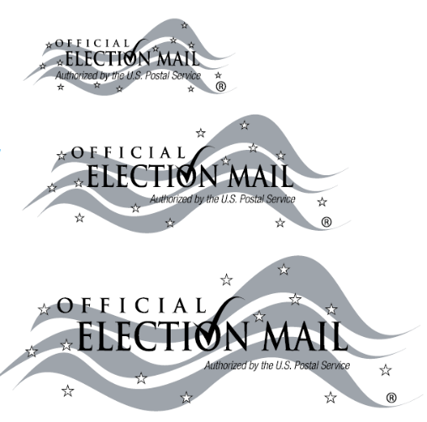
Publication 631
Logo Sizing
Small Use:
Use the small application only on labels, postcards, and envelopes that do not exceed 4 1/8” x 9 1/2” (Standard #10 envelope)
Medium Use:
Use the medium application on small-to medium-sized envelopes that exceed 4 1/8” x 9 1/2”
Large Use:
Use the large application on placards and all other envelopes, which are large and oversized
Notes:
There are three options for sizing of the Official Election Mail logo.
1. Use the small application only on labels, postcards, and envelopes that do not exceed 4 1/8” x 9 1/2” (Standard #10 envelope). The TM is set in Helvetica Neue Light 45 at 5 pt. "Authorized by the U.S. Postal Service" is set in Helvetica Neue 47 Light Condensed Oblique at 8 pt. These sizes must not be altered. The font for "Official Election Mar is Trajan Bold all caps. "Official" is set in Trajan Bold at 7 pt. and "Election Mail" is set in Trajan Bold at 13.75 pt. This logo cannot be resized and must be used at the size shown.
2. Use the medium application on small-to medium-sized envelopes that exceed 4 1/8” x 9 1/2”. The TM is set in Helvetica Neue Light 45 at 6 pt. "Authorized by the U.S. Postal Service" is set in Helvetica Neue 47 Light Condensed Oblique at 8 pt. These sizes must not be altered. The font for "Official Election Mail" is Trajan Bold all caps. "Official" is set in Trajan Sold at 10.5 pt. and "Election Mail" is set in Trajan Bold at 21 pt.
This logo cannot be resized and must be used at the size shown.
3. Use the large application on placards and all other envelopes, which are large and oversized. The TM is set in Helvetica Neue Light 45 at 6 pl. "Authorized by the U.S. Postal Service" is set in Helvetica Neue 47 Light Condensed Oblique at Opt. 'Official Election Mail" is set in Trajan Bold all caps. The word "Official" is 14 pt. and "Election Mail" is 27.5 pt. This logo cannot be resized and must be used at the size shown.

Slide 40
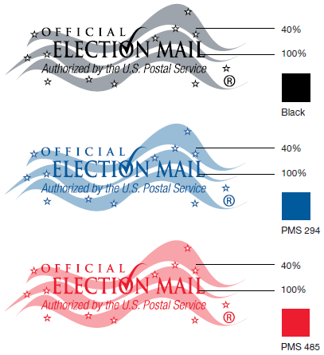
Publication 631
Color & Print Specifications
Print the Official Election Mail logo using one of these color options:
Black
PMS 294 Blue
PMS 485 Red
Print the logo only on a light colored background
Print the stripes/waves at 40 percent of the selected color
Notes:
Print the Official Election Mail logo using one of these color options:
Black
PMS 294 Blue
PMS 485 Red
Print the logo only on a light colored background, and print the stripes/waves at 40 percent of the selected color.

Slide 41
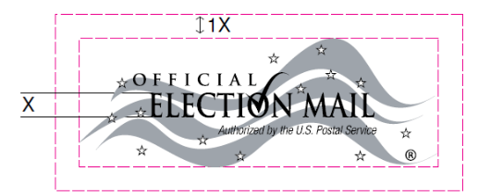
Publication 631
Clearance Area
For the small, medium, and large logo, use a minimum 1X clearance area around the entire logo
Do not place other graphics inside the clearance area, this includes the address, postage, and return information
There must be at least 1X clearance area between the top of the logo and top of the envelope, postcard, or label
Notes:
For the small, medium, and large logo, use a minimum 1X clearance area around the entire logo (where X is the height of the letter E in Election). Do not place other graphics inside the clearance area, this includes the address, postage, and return information. There must also be at least 1X clearance area between the top of the logo and top of the envelope, postcard, or label.

Slide 42
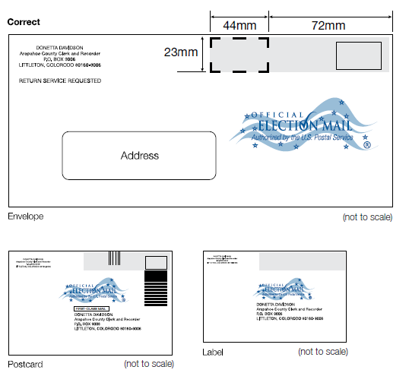
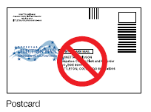
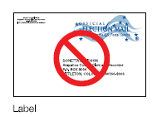
Publication 631
Correct
Incorrect
Notes:
This past year, the placement of the Official Mail Logo was changed at the request of Supervisor Of Elections Office’s nationwide. This change now allows for the logo to be below its original defined outline at the top of the mail envelope as shown in the diagram. These new guidelines will allow for the cancelation of ballot markings to be clearly visible without distortion due to logo interference.

Slide 43
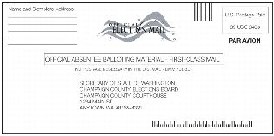
Design Election Mail
Mailing Permit
Business Reply Mail
Nonprofit
First-Class Mail Auto US Postage Paid Washington, DC Permit 423

Slide 44
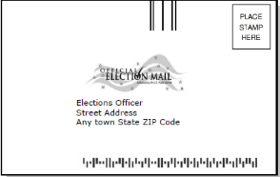
Design Election Mail
Business Reply Mail
Permit required
Only pay for returned pieces
Courtesy Reply
No permit required
Voter pays postage
Metered Reply Mail
Permit Reply Mail

Slide 45
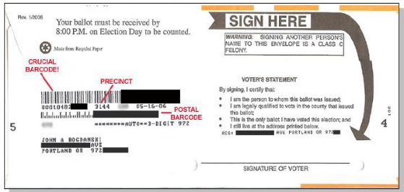
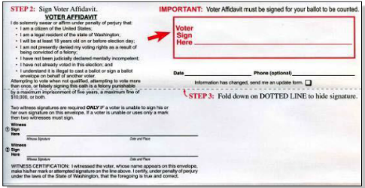
Design Election Mail
Caution
Ballot Return Envelope with addresses, numbers and barcodes printed on back MAY cause ballot to be misdirected or delayed!

Slide 46
Agenda
Political Campaign Mail
What is Political Campaign Mail?
How important is mail to a campaign?
6 reasons to use direct mail
7 rules of successful direct mail
Prepare Political Campaign Mail
Mail classes
Intelligent Mail Barcode (IMb) & Tracing
QR codes & emerging technologies
Incentives & Promotions
Postage Statement Changes
EDDM
Alternate Postage Program
Design Political Campaign Mailpiece
Submit Political Campaign Mailings for Acceptance
5 Ways to Submit Mail
Identifying Political Campaign Mail
Official Election Mail
What is Official Election Mail?
Prepare Official Election Mail
Mail classes
Postage Statement Changes
Mailing Standards
Intelligent Mail Barcode (IMb) & Tracing
AFO/APO Absentee Ballots
Requirements for Official Election Mail
Design Official Election Mailpiece
Publication 631
MDA Support
Submit Official Election Mailings for Acceptance
5 Ways to Submit Mail
Identifying Official Election Mail
Resources
Notes:
Let’s begin with an explanation of Political Campaign Mail.

Slide 47
Five Ways to Submit Mail
There are 5 ways that mailers can submit mail:
Mail.XML™
Intelligent Mail Small Business Tool (IMsb)
Postal Wizard
Mail.dat
BMEU Hardcopy Postage Statement
eDoc Submission Methods
Notes:
There are 5 ways that mailers can submit mail: the first is by hardcopy postage statement, and the other four utilize electronic documentation, or eDoc. eDocs can be submitted through the following methods:
Mail.dat allows the mailer to use their own software or vender software to create electronic files. Mail.dat is an electronic file that represents the mailing, contains the Postage Statement and qualification information, and uses a fixed file format to send mailing information.
Mail.XML™ allows the mailer to use their own software or vendor software to create electronic files. Mail.XML™ is an electronic message that represents the mailing, and contains the Postage Statement and qualification information. Mail.XML™ allows two-way conversational communication between USPS and the mailer’s submission systems, letting the customer select and correct data fields submitted.
Postal Wizard is a USPS tool that allows the mailer to type information into an online form that creates an electronic postage statement. Separate software is needed to generate barcodes.
The Intelligent Mail Small Business Tool (IMsb) is a web-based tool for creating Full-Service mailings. The IMsb prints an IMb on pieces and tray labels, and creates a Full-Service electronic postage statement which serves as the electronic documentation, or eDoc. This tool can be used to create mailings of less than 10,000 pieces and is limited to an annual volume of less than 250,000 pieces.
Access to the PostalOne! system is required to submit electronic documentation using any of the methods listed above. In the coming slides we will review how your mailer submits electronic documentation using each of these methods. This information is provided so you can assist the mailer through the process, if needed.

Slide 48
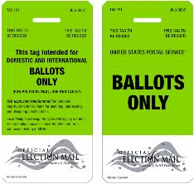
Identifying Official Election Ballot Mail
Mailers must use Green Tag 191 Domestic and International Ballots to identify trays and sacks that contain ballot mail
Tag 191 can ONLY be applied to Vote-by-Mail Ballot and Absentee Ballot mailings
Notes:
Business Mail Entry Units and Detached Mail Units will supply authorized voting registration organizations with the Green Tag 191, Domestic and International Ballots only for certain types of official election mail. The tag provides greater visibility to ballot mail during Postal Service handling.
Tag 191 is used to identify trays and sacks containing mail-in ballots. It can only be used to identify Official Election Mailings of Vote-by-Mail Ballots and Absentee Ballots destined for either domestic or international addresses. Please note that Voter Registration Cards, Absentee Applications, and Polling Place Notifications are NOT eligible for Green Tag 191.

Slide 49
Agenda
Political Campaign Mail
What is Political Campaign Mail?
How important is mail to a campaign?
6 reasons to use direct mail
7 rules of successful direct mail
Prepare Political Campaign Mail
Mail classes
Intelligent Mail Barcode (IMb) & Tracing
QR codes & emerging technologies
Incentives & Promotions
Postage Statement Changes
EDDM
Alternate Postage Program
Design Political Campaign Mailpiece
Submit Political Campaign Mailings for Acceptance
5 Ways to Submit Mail
Identifying Political Campaign Mail
Official Election Mail
What is Official Election Mail?
Prepare Official Election Mail
Mail classes
Postage Statement Changes
Mailing Standards
Intelligent Mail Barcode (IMb) & Tracing
AFO/APO Absentee Ballots
Requirements for Official Election Mail
Design Official Election Mailpiece
Publication 631
MDA Support
Submit Official Election Mailings for Acceptance
5 Ways to Submit Mail
Identifying Official Election Mail
Resources
Notes:
Let’s begin with an explanation of Political Campaign Mail.

Slide 50
Resources
2016 Official Election Mail Program Kit:
Tag 191 Fact Sheet and Sample Tag
IMb Tracing Fact Sheet
Steps to Creating Your Intelligent Mail® Barcode Fact Sheet
Special Procedures APO/FPO Absentee Ballots Fact Sheet.
Official Election Mail Program: an Overview for Election Officials Fact Sheet
Publication 631, Official Election Mail—Graphic Guidelines and Logos
Publication 632, State and Local Election Mail—User’s Guide
Notes:
■■Tag 191 Fact Sheet and Sample Tag — Information and guidelines to help your Election Mail get higher visibility during processing.
■■IMb Tracing® Fact Sheet — A rundown of what IMb Tracing is and how you can benefit.
■■Steps to Creating Your Intelligent Mail® Barcode Fact Sheet — Learn how to create your own IMb® to track ballots while in the mail stream and more.
■■Special Procedures APO/FPO Absentee Ballots Fact Sheet — Tips to ensure absentee ballots reach military personnel who are currently overseas.
■■Official Election Mail Program: an Overview for Election Officials Fact Sheet — Overview of the many benefits of using mail during the election process.
■■Publication 631, Official Election Mail—Graphic Guidelines and Logos — Learn proper usage of the Official Election Mail logo for inclusion on mailpieces.
■■Publication 632, State and Local Election Mail—User’s Guide — Contains information that election officials must consider before mailing Election Mail.
ve special handling.

Slide 51
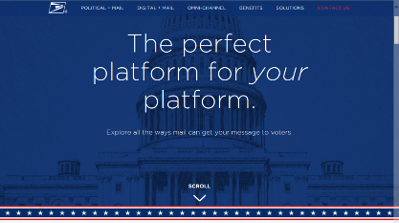
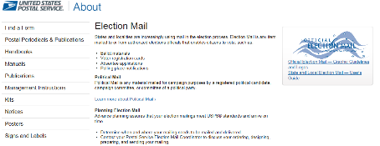
Resources
Deliver the Win: http://www.deliverthewin.com/
These sites provide
information on:
Vote-by-Mail
IMb Tracing
Training & Tools
USPS Election Mail Website:
http://about.usps.com/gov-services/election-mail/

Slide 52
Resources
Green Tag 191 Fact Sheet and Sample Tag: Information and guidelines to help your Election Mail get higher visibility during processing.
https://www.usps.com/election-mail/tag-191-election-mail-kit.pdf
Special Procedures APO/FPO Absentee Ballots Fact Sheet: Tips to ensure absentee ballots reach military personnel who are currently overseas.
https://www.usps.com/election-mail/apo-fpo-election-mail-kit.pdf
Red Tag 57: Learn about proper use of Tag 57 and political eligible mail classes.
http://blue.usps.gov/bma/_pdf/Tag%2057%20Political%20Campaign%20Mail.pdf

Slide 53
Resources
Publication 631—Official Election Mail – Graphic Guidelines and Logos: Learn about proper use of the Official Election Mail logo for inclusion on mailpieces
http://about.usps.com/publications/pub631.pdf
Publication 632—State and Local Election Mail User’s Guide: Contains information that election officials must consider before mailing
http://about.usps.com/publications/pub632.pdf
Domestic Mail Manual (DMM) 703: Non-profit Standard Mail and Other Unique Eligibility
703.1.3: Qualified Political Committees and State and Local Voting Registration Offices
703.2: Overseas Military Mail
703.5: Free Matter for the Blind and Physically Handicapped Persons
703.8: Absentee Ballot Materials

